Slide 1
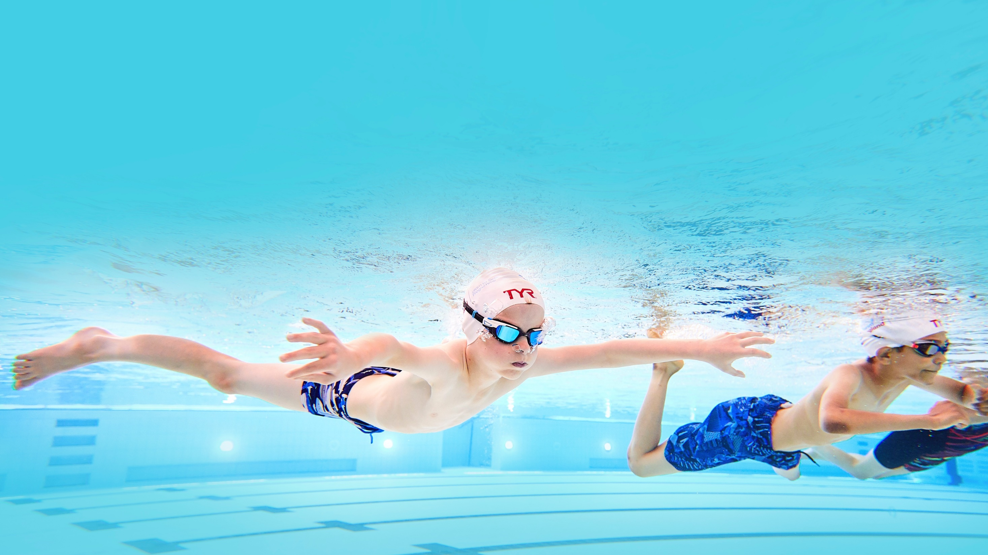

School Swimming and
Water Safety Charter
School Assembly
Water Safety Presentation

Slide 2


Water is Fun!
Notes:
Explain to your pupils that water is fun, but that it is very important to stay safe near water.
What are some fun things that you can do in water?

Slide 3






Fun things you can do in the water
Swim with your friends
Play water polo
Body board and surf
Snorkel
Water slides

Slide 4


Water in and around your home
Bath
Washing machine
Paddling pool
Sink
Water butt
Fish pond
Notes:
Ask the pupils how many things they can think of that contain water at home
Some suggestions are provided on this slide, pupils may come up with lots more

Slide 5

On your way to school
How many of you travelled past ‘open water’ on your way to school
and what kind of water was it?
Canal
River
Stream
Reservoir
Lake
Sea
Notes:
Ask the pupils how many of them travelled past open water on their way to school and what kind of water was it?
Canal
River
Stream
Reservoir
Lake
Sea

Slide 6
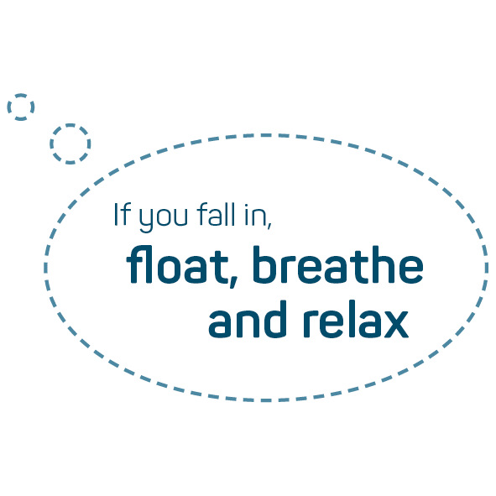
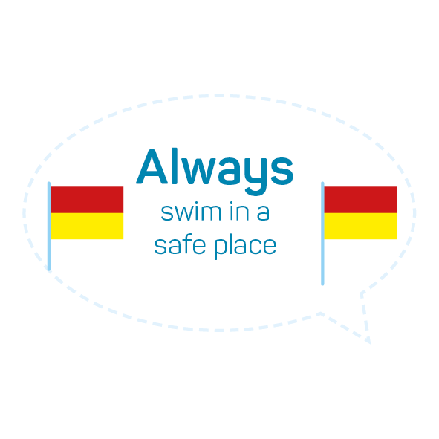

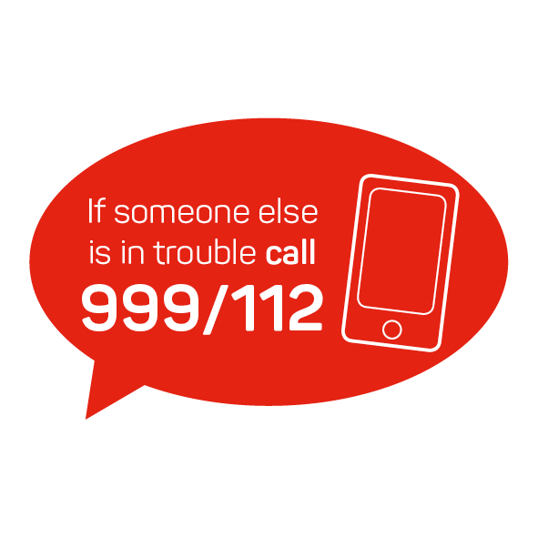
Water safety messages to remember

Slide 7
Water Safety Quiz

Slide 8
Water safety quiz
  How do you know it is a safe place to swim?
  What other things do you need to think about?
  Why should you swim with an adult?
  Should you ever swim alone?
  Where is a safe place to swim?
Notes:
Always swim in safe place:
How do you know it is a safe place to swim?
If it is lifeguarded
Look for flags – opens discussion on what the flags mean (slide 16)
What other things do you need to think about?
Stop and Think:
Water is always moving.
The water is colder than you think.
Edges can be dangerous.
There may be dangers under water.
Plan for your activity – check weather, tide times, get local advice and wear the right clothing
Always swim with an adult:
Why should you swim with an adult?
To keep you safe
Should you ever swim alone?
NO
Where is a safe place to swim? – discussion on where pupils feel is safe and why
Swimming Pool
Lifeguarded beach or water
Other areas to think about:
Stay Together
Never swim alone - Stay close to a friend or family member.
Find a safe place to go - Only swim where there is a lifeguard.

Slide 9
Water safety quiz
  What happens to your body when you fall into cold water?
  Why is it important to float on your back?
  How would you signal for help?
  How can you keep warm in the water?
  How would you help someone in the trouble in the water?
  Would you go into the water to help?
  Who information would give when calling emergency services?
  What objects could you throw to help them float?
Notes:
Float, breathe, relax
What happens to your body when you fall into cold water?
Cold water makes breathing really hard, it takes your breath away
Arms and legs get hard to move (shock, lack of oxygen)
This is why you need to relax to allow your breathing to return to near normal
Why is it important to float on your back?
To allow your breathing to get back to normal after the shock of cold water
Gives you time to relax and assess the situation
If you fall in, float until you feel calm
How would you signal for help?
Tread water, raise one arm (still, not waving) and shout for help
How can you keep warm in the water?
If you can, swim to safety or hold on to something that floats.
Hold onto something that floats and take up the HELP position
If in a group, huddle together around a floating object and shout for help
Learn how to help in an emergency Call 999 or 122
How would you help someone in trouble in the water?
If you see someone else in trouble in the water call 999 or 112.
Shout for help
Look for something you can throw to help them float, a life ring or even a football could help.
Keep watch until help arrives.
Would you go into the water to help?
NO!!
Never enter the water to save others.
What information would you give when calling emergency services?
Exactly where you are
Your name
What is happening
Name of the person in trouble (if you know it)
What service is wanted

Slide 10
Skills to keep you safe

Slide 11
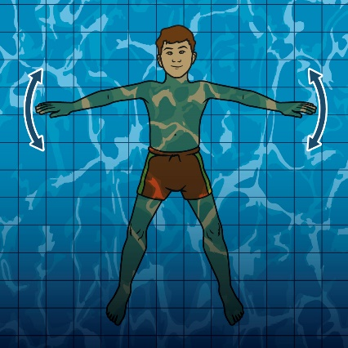
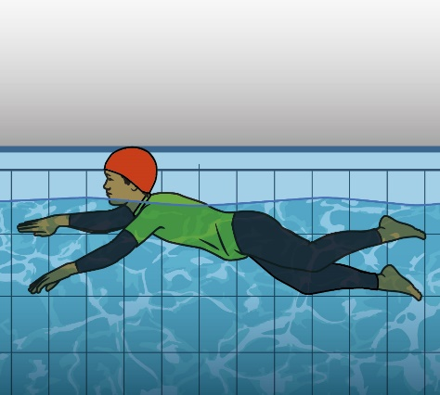
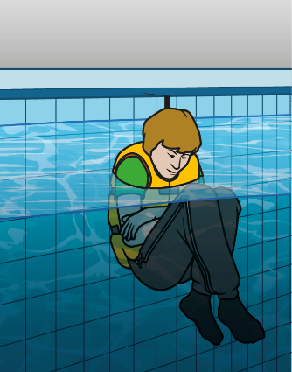
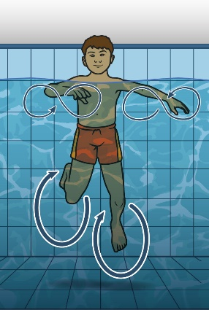
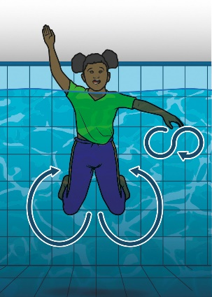
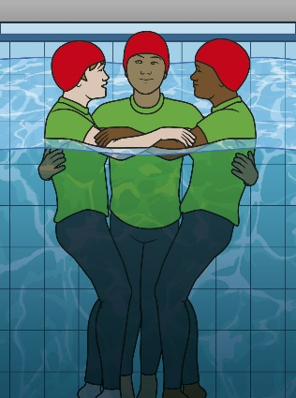
Skills to keep you safe
Float
Survival
Stroke
Heat Escape
Lessening
Position
(HELP)
Treading Water
Signal for help/Attract
attention
Huddle

Slide 12
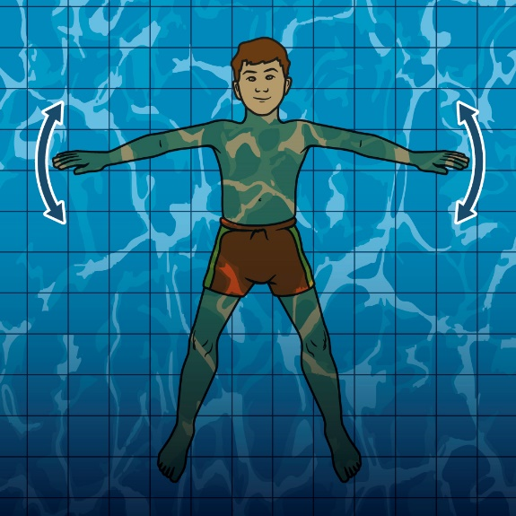
Floating
Why?
To help you get control of your breathing.
When?
If you fall in unexpectedly or to rest.
How?
On your back, with your head supported by the water,
arms and legs spread out.

Slide 13

Treading water
Why?
Energy efficient way to stay afloat and stationary.
When?
When you need to stay in one place and can’t stay afloat.
How?
Upright in the water using a leg action that is effective and sculling with your hands.

Slide 14
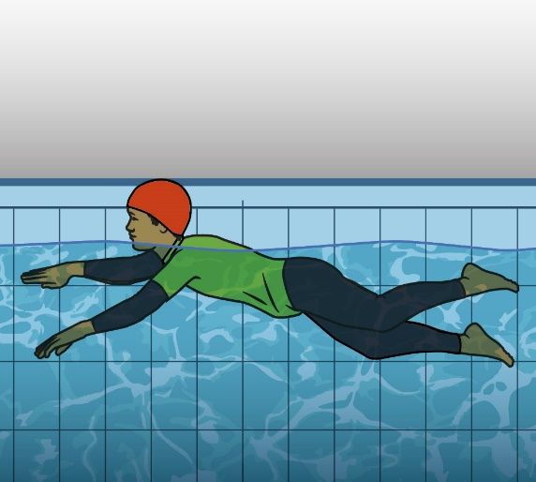
Survival Stroke
Why?
To keep arms under water, saves energy, keeps head out
of the water and preserves heat and see the place you
are travelling to.
When?
When you need to conserve energy and heat and you
have decided it is safe to travel to safety.
How?
On your front, head out of the water, alternating arm action. Hands pull under the water and close to body, using different
leg kicks.

Slide 15

Signal for help
Why?
When you can’t self-rescue or need the attention of others.
When?
If you fall in unexpectedly or get tired.
How?
Holding on to a floating object or treading water, raise one
arm in the air and shout help.

Slide 16
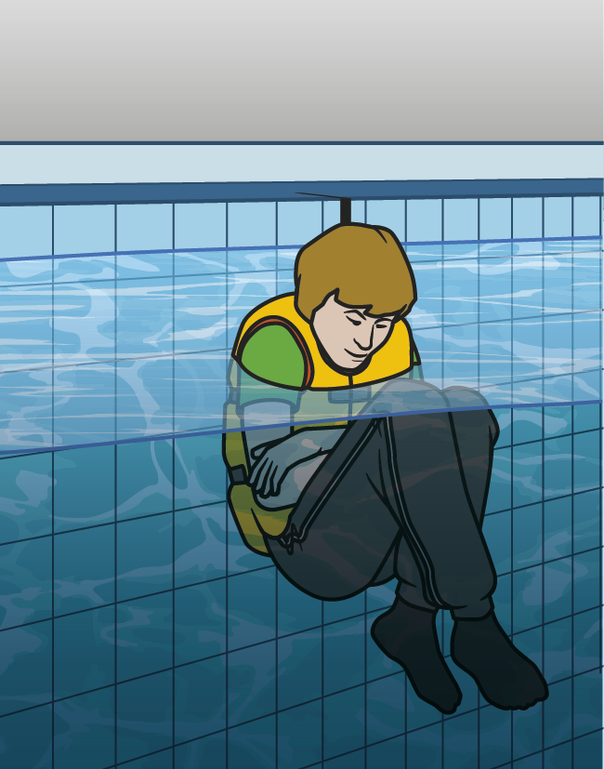
Heat Escape Lessening Position
(HELP)
Why?
To retain heat, energy, stay calm and visible.
When?
If you are in cold water and need to wait to be rescued.
How?
Wrap arms across your chest with any type of floating object under them, press your legs together and pull your knees to your chest.

Slide 17

Huddle position
Why?
To maintain heat, keep a group together or support a weak swimmer while waiting for help.
When?
If you fall in unexpectedly or need to keep a group together.
How?
Hold on to anything that floats, hold each other around the
waist or link arms. One of you must raise a hand to signal for help.

Slide 18




Know your beach flags
On beaches patrolled by lifeguards, different flags tell you where
it’s safest to swim and which areas are designated for water sports:
Swimming zone
Lifeguards patrol this area, it is the safest place to swim,
body board and use inflatables.
Hard craft zone
Area for water sports such as surfing only – no swimming.
Offshore winds
shows the direction and force of the wind.
No Swimming
Danger NEVER go into the water when the red flag is flying.

Slide 19

Activities

Slide 20




Activities
Run to the beach flag you think answers the question
and find out if you are right!
Notes:
Place the coloured beach flags around the classroom/PE hall
Teacher asks a question relating to a coloured flag
Pupils run to that coloured flag they think is correct

Slide 21
Activities
In pairs, quiz each other on the key water safety messages.
Produce a water safety poster for children in the year below.
Work in groups to produce a beach flag – and explain what
it tells you about water safety.

