Slide 1
Swimming Pool Water the publication
Rob Johnston
Food, Water and Environmental Scientist (Out-posted)
Public Health England

Slide 2
Swimming pool guidance;
a little history and where we are now with recreational water guidance, including;
PWTAG SWIMMING POOL WATER;
an overview of the chapters – and how it helps operators and investigators secure effective water management
PWTAG Code of Practice and Technical notes;
Other resources that can be accessed and part ‘n’ parcel of PWTAG guidance for recreational waters

Slide 3
The Not so Recent History - Swimming Pool Water Management
Ministry of Health, The Purification of the Water of Swimming Baths HMSO, 1929
Ministry of Health, the Purification of the Water of Swimming Baths, HMSO, 1951
Department of the Environment, The Purification of the Water if Swimming Pools, HMSO, 1975
Department of the Environment Circular 72/78 Statement on the Use of Chlorine gas in the Treatment of Swimming Pools, HMSO, 1978
Department of the Environment, Committee on Chemicals and Materials of Construction for Use in Public Water Supply and Swimming Pools, Fourteenth Statement, DOE, 1984
Department of the Environment, Swimming Pool Disinfection Systems using Sodium Hypochlorite – Guidelines for Design and Operation, HMSO 1979

Slide 4
Department of the Environment, The treatment and quality of swimming pool water, HMSO, 1986
First edition 1929
Revised 1951 and 1975
Revision in 1986 – to update on disinfection following advice in government circulars, which included ceasing disinfection using chlorine gas
  New chapters on filtration and circulation
  New chapters on water treatment problems in other pool designs – eg Leisure pools and spa pools

Slide 5
Department of the Environment, The treatment and quality of swimming pool water, HMSO, 1986
Introduction
The Need for Purification
Disinfection
pH and Other Chemical Treatment
Testing the Pool Water
Filters and Filtration
Circulating Patterns and Recirculation
Ancillary Plant Plant Operation
Water Quality Guidelines for Swimming Pools
Special Pools

Slide 6
Public Health Act 1936
Section 231
‘A local authority may make byelaws with respect to public bathing , and may make such byelaws ‘ –
Regulate the areas in which, and the hours during which, public bathing shall be permitted
…… but section 231 largely related to bathing areas, and included provision to prescribe bathing costumes to be worn
Section 233
‘A local authority may make byelaws with respect to swimming baths and bathing pools whether open or covered, which are not under their management for
(a) Securing the purity of the water therein‘

Slide 7
Sanitary Inspectors Handbook 1947
‘Swimming bath waters are treated by means of rapid filters of the pressure type, the size of the plant being arranged so that the contents of the pool are filtered in a period of time depending upon the number of bathers using the bath.
Suitable treatment, filtration, aeration and sterilisation by chlorine gas ensure that the water in the pool is maintained in an attractive and safe condition.’

Slide 8
Clays Handbook of Environmental Health
First edition 1933 – (extract below from 1981)
‘Proper Chlorination should yield a water free from any coliform organisms in 100ml’
Also commonly known as "indicator organisms", coliform refers to a wide variety of bacteria that can be found throughout the environment.
These organisms can be found;
Soil
Water surfaces
Plants
Skin or intestinal tract of warm-blooded organisms such as humans

Slide 9
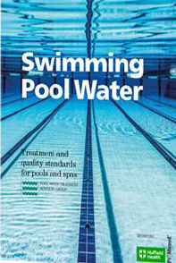
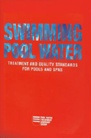
Swimming Pool Water - PWTAG
Swimming Pool Water; The essential guide for pools - updated!
A guide for;
Designers
Suppliers
Operators
Managers
Investigators
Publication/Release date; November 22nd 2017
Also note erratum information on PWTAG website
Compiled with a ‘conventional’ pool in mind;
Principles apply for all types of pool
Discusses variable pool types and configurations

Slide 10
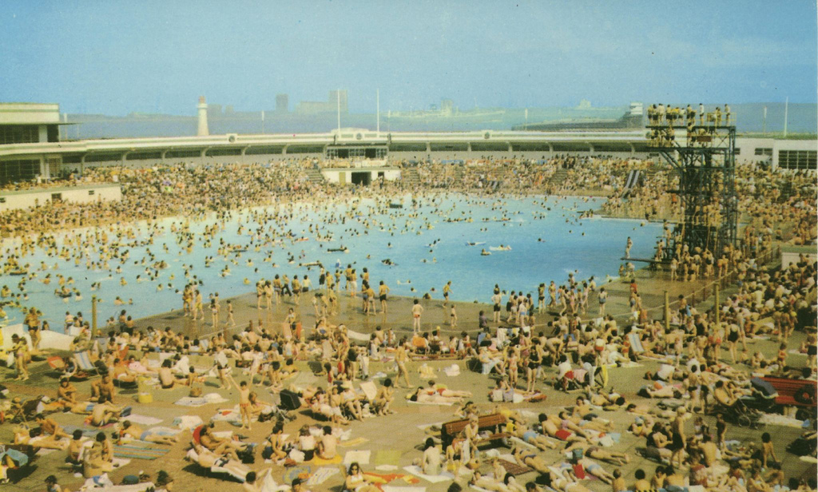
Pool Water Challenges
Opened in June 1934 - costing more than £90,000………..
In the first two months after opening, more than 1,000,000 million people passed through the turnstiles

Slide 11
Swimming Pool Water Management
Three key parts to PWTAG Guidance
SWIMMING POOL WATER; the book!
PWTAG Code of Practice;
a structured plan for the technical operation of their pool.
ensures the technical operation of a pool meets quality standards that provide a healthy experience for swimmers
provides a model of operation based on the authority of PWTAG good practice.
gives an assurance that the pool meets essential pool operational standards.
Technical Notes;
Updates or new material for the standards and guidance given in the PWTG book, Swimming Pool Water and the PWTAG Code of practice
To be read in association with the other publications.
https://www.pwtag.org/technical-notes/

Slide 12
Swimming Pool Water
Chapter 1, 2, 3 – what is a swimming pool, types of pool, pollution and hygiene
Chapter 4 – Management and training
Chapter 5 - Design
Chapter 6, 7, 8, 9 – hydraulics, filtration, disinfection, dosing
Chapter 10,11 – Pool water chemistry, testing and controlling
Chapter 12, 13 – Healthy Swimming and dealing with outbreaks

Slide 13
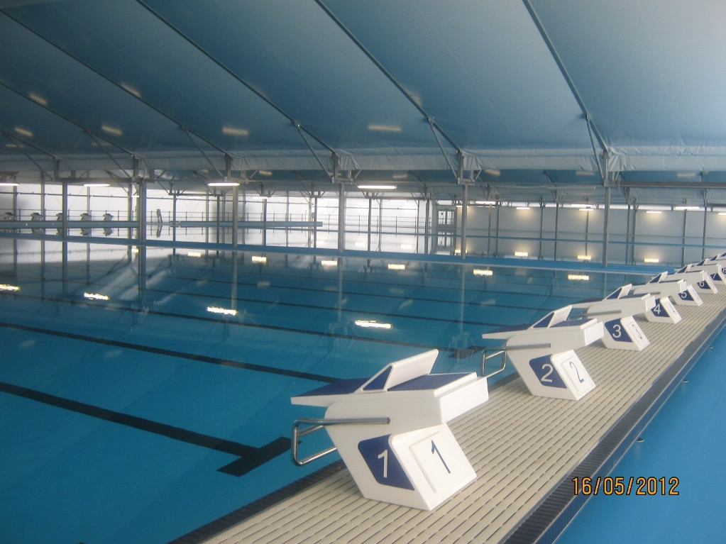
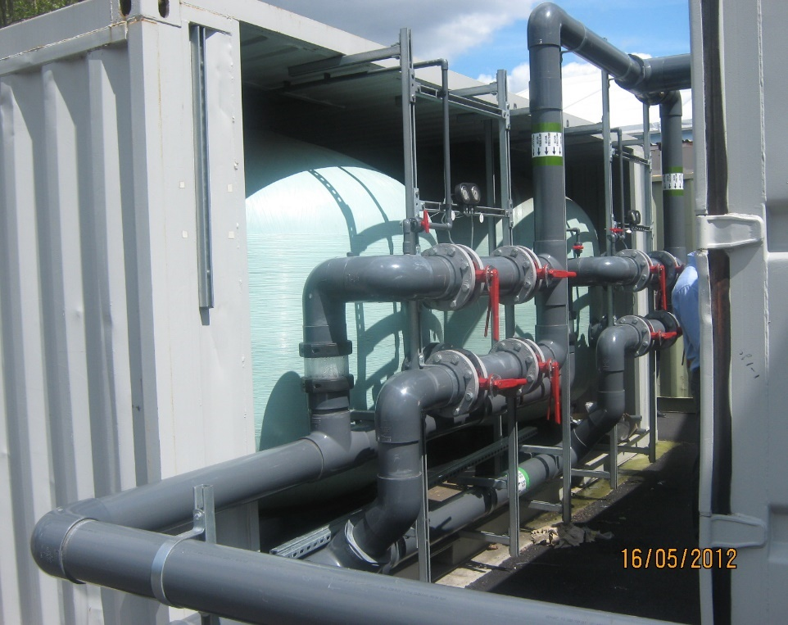
Swimming Pool Water –
Chapter 2; Types of Pool
Pools needed temporarily; hydraulics and water treatment should be as for a conventional pool

Slide 14
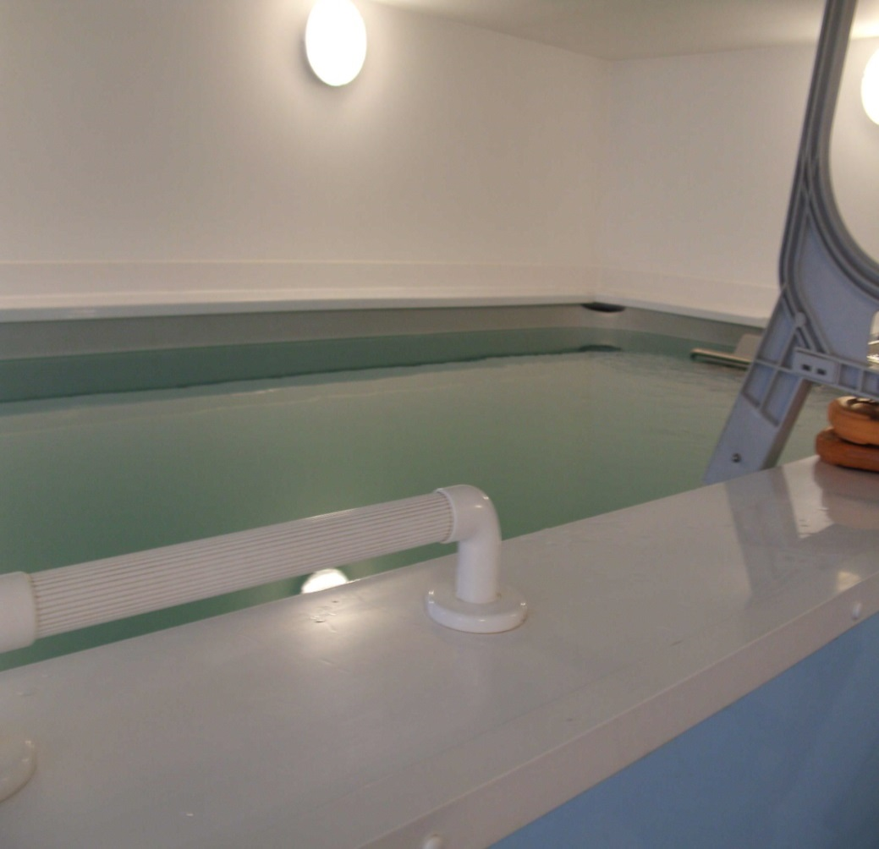
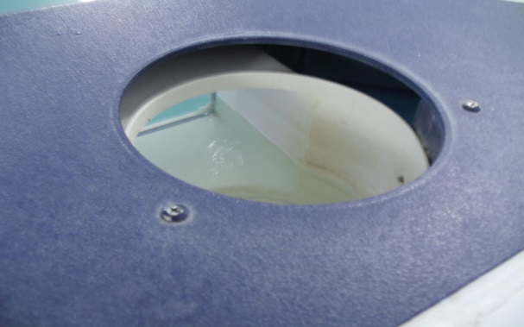
Swimming Pool Water –
Chapter 2 Types of Pool
Counter current pools – small pools with mechanically derived current can effectively increase swimming exercise in a limited area – but must be managed effectively

Slide 15
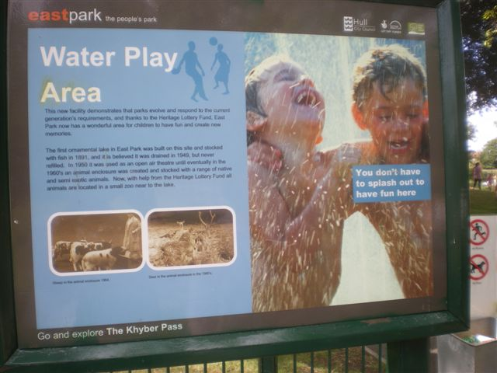
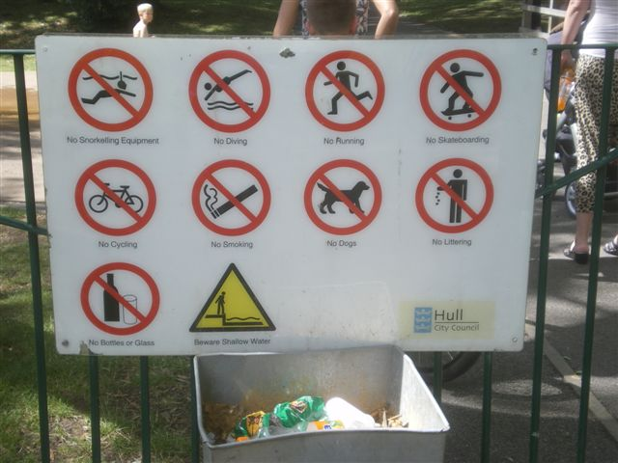
Swimming Pool Water – Chapter 2 Types of Pool. Outdoor swimming pools can have particular challenges (Chapter 22)
….and preferably not using the water as a hygiene facility or using the surrounding area to carelessly throw away disposable nappies (used)

Slide 16
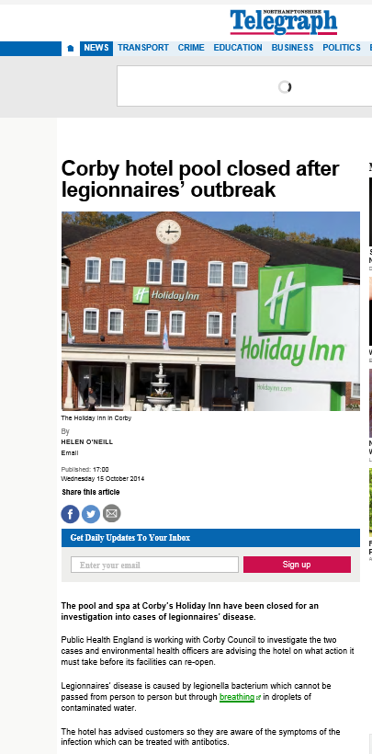
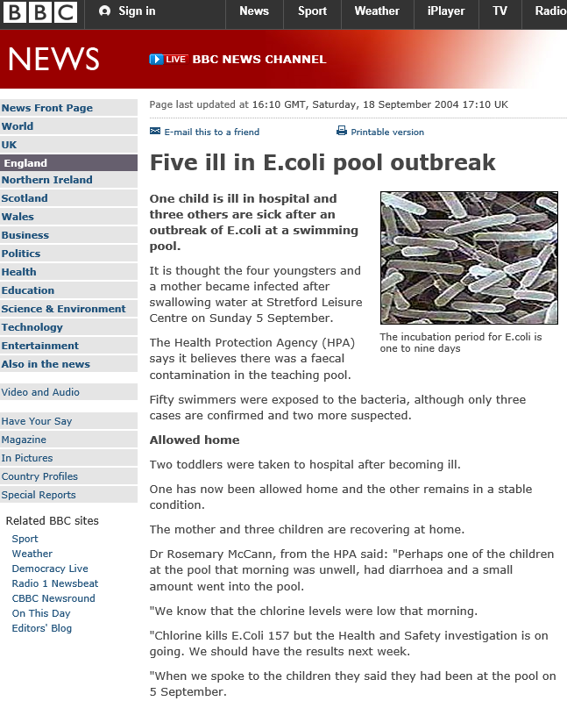
Swimming Pool Water
Chapter 3; Pollution and hygiene
Poor pool management can result in all sorts of problems! ………

Slide 17
What Happens if We Don’t Manage Water Effectively?
Detection/illness
Reporting (variable)
Response
Exposure
Laboratory
Confirmation
Aim - early detection and intervention/control
Or how about …..good design, management, maintenance, systems and thus prevention?
CASES
DAY

Slide 18
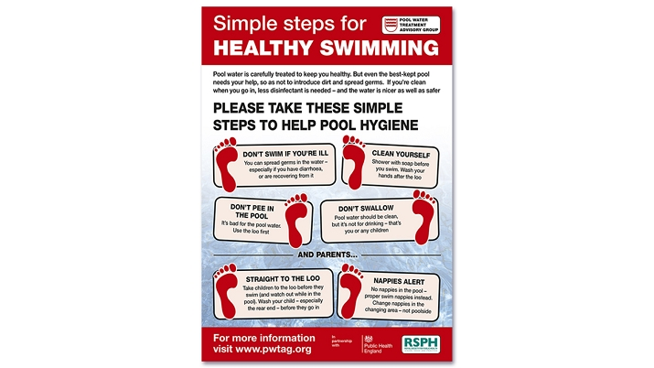
Swimming Pool Water
Chapter 3; pollution and hygiene
Pollution from bathers
Pre-swim hygiene
Babies in warm water pools
Dilution with fresh water
Risk assessment
When not to swim ……….
https://shop.swimming.org/PWTAG-Encapsulated-Healthy-Swimming-Poster

Slide 19
Swimming Pool Water
Chapter 13 Dealing with Outbreaks
Why investigate outbreaks?
Stop the outbreak - and protect public health
Understand what happened - and why?
Put in control measures - and prevent future outbreaks / incidents
Reduce the risk of secondary infection - family contacts, schools, workplaces etc
Improve surveillance and outbreak detection
improving our knowledge and the science base, reducing the impact on public health and the costs to individuals, service providers and health care systems etc
But Prevention is better than cure …….

Slide 20
Swimming Pool Water
Chapter 12; Healthy Swimming –
Infections of Potential Concern
Acanthomoeba
Adenovirus
Cryptosporidium
Dermatophyte fungi
E coli
Enterovirus
Giardia
Hepatitis A
Legionella
Leptospira
Microsporidia
Molluscum contagium virus
Mycobacterium marinum
Mycobacterium avium
Naegleria fowleri
Pappilloma virus
Pseudomonas
Shigella
Trichobilharzia, Scistosoma

Slide 21
Swimming Pool Water -
Chapter 14 – Microbiological testing
Chapter 15 – Chemical safety
Chapter 16 – Plant maintenance
Chapter 17 – Cleaning
Chapter 18 – Personal Protective Equipment
Chapter 19, 20, 21, 22, 23, 24, 25, 26 – Spa pools, leisure pools, hydrotherapy pools, outdoor swimming and paddling pools, pools in other locations and domestic pools. Interactive water features and swimming ponds

Slide 22
Swimming Pool Water
Chapter 10; Pool Water Chemistry; management and monitoring
Pool water parameters – determined after risk based assessments (water safety plans) – know your water and understand your treatment regimen
Monitoring programmes – documented monitoring
Disinfectant regime – suitable for the pool
Pool water chemistry – more than merely the addition of chemicals
Review of operational systems in light of incidents and monitoring

Slide 23
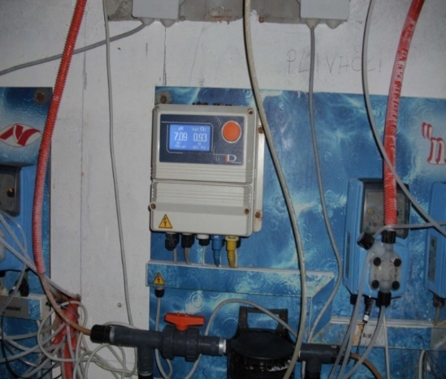
Swimming Pool Water - PWTAG
Chapter 10; Pool Water Chemistry; management and monitoring – pH and testing
pH impact on efficacy of disinfectant
Regular monitoring of pH – continuous/every 2 hours (subject to use) – or at least three times a day
(Spa pools - tested at least twice a day, confirmed by risk assessment)
Calibration of automated dosing systems
pH correction – subject to disinfectant in use

Slide 24
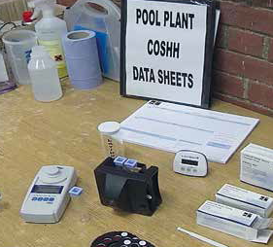
Pool Water Chemistry - PWTAG
Chapter 10; Pool Water Chemistry; management and monitoring – pH and testing
Routine testing is essential
Responding to issues – and identifying the root cause of any issues
Monitoring – before pool opens and at closing
Automatic monitors - checked daily
Manual monitoring - still required
Monitoring samples – representative
Test kits – use of kits and training of operators

Slide 25
Swimming Pool Water - PWTAG
Overview of benefits and potential issues
Potential infections – understanding potential pathogens and safety issues
Respiratory issues and infections
Skin and foot infections -
Eye irritation – including advice for contact lens wearers
Rashes and folliculitis – chemical and bacterial issues
Ear and sinus infections -
Gastro-intestinal infections – including water borne protozoa
Swimming as part of a healthy lifestyle
Swimming as a pastime, source of fun, enjoyment
Swimming skills - for personal safety

Slide 26
Un- Healthy Swimming;
What can happen if we lose control of water management ?
8 cases of E coli O157 - Trafford area of the Manchester conurbation, 2004
Analysis of the questionnaires established a link that all four cases had been swimming in the learners’ pool of a local leisure centre
No obvious source of E. coli O157 was found – but epidemic curve, descriptive epidemiology and laboratory data consistent with a single contamination event such as faecal incontinence event on the morning – before exposure
On that Sunday morning, the level of free chlorine in the pool was ‘probably <0.5 mg/l - inadequate to disinfect the pool’.
http://www.ncbi.nlm.nih.gov/pmc/articles/PMC2870659/pdf/S0950268807007947a.pdf
Notes:
4 cases of E coli O157 - Trafford area of Manchester 2004
Analysis of the questionnaires established a link that all four cases had been swimming in the learners’ pool of a local leisure centre
‘Although no obvious source of E. coli O157 was found for the current outbreak, the epidemic curve, descriptive epidemiology and laboratory data are consistent with a single contamination event such as faecal incontinence on the morning of Sunday, 5 September.’
On that Sunday morning, the level of free chlorine in the pool was probably <0.5 mg/l which would have been inadequate to disinfect the pool.
North West –
8 confirmed cases of E Coli O157
2 developed HUS
Epidemiology and other data linked to a faecal incident
Investigations revealed low levels of free chlorine etc
Water reported as cloudy on the day
Prosecution costs of Leisure Trust was £7500

Slide 27
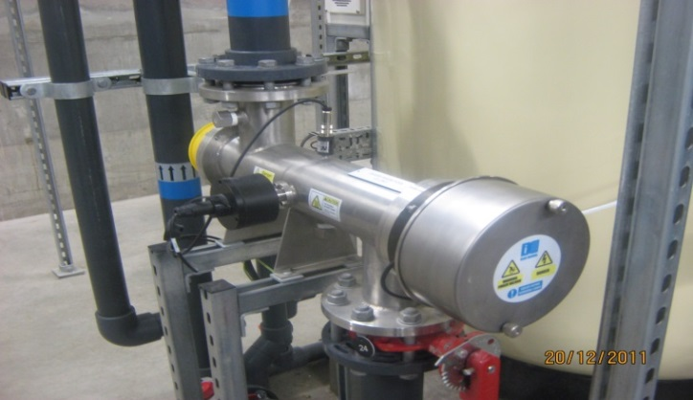
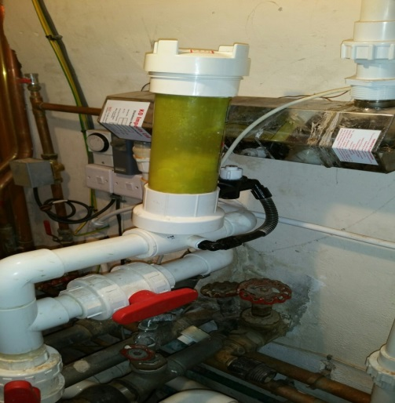
Swimming Pool Water -
Chapter 13; Outbreaks
Inadequate water disinfection / inadequate residual
Sewage cross contamination
Inadequate filtration
Backwash issues
Ozone treatment – not operating correctly
Cross contamination from poolside areas and/or poor poolside cleaning regimes
Towel sharing
Issues with the domestic hot and cold water system
No pre-swim showering
Vomit in pool water
Bathing loads too high

Slide 28
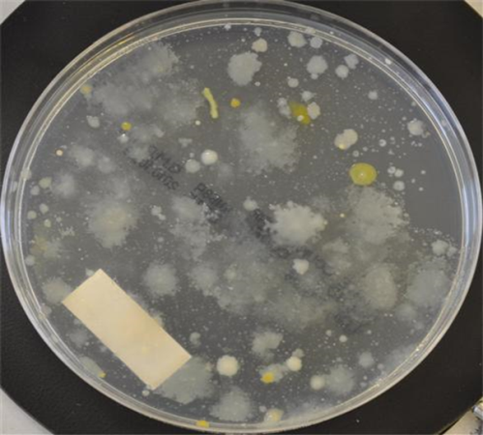
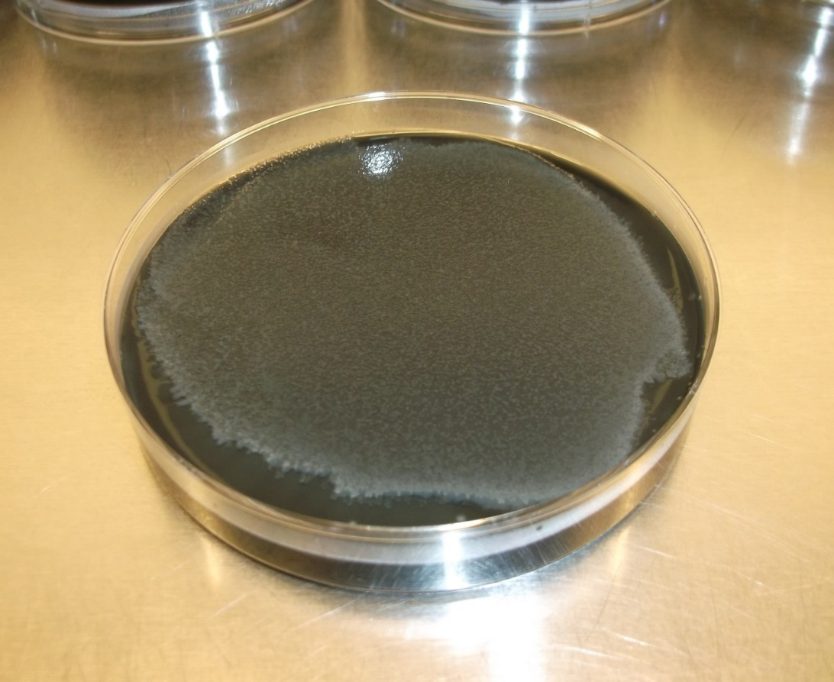
Swimming Pool Water
Chapter 14; Microbiological testing;
Micro problems in a well designed and operated pool ?
Testing – as appropriate intervals (verification of water management) – monthly for commercial pools, weekly for hydrotherapy pools
‘It should not be necessary to take frequent samples for microbiological examination……….’
Sampling – on commissioning / re-commissioning a pool
Sampling if treatment failures
Sampling after an incident investigation with impact on bathers health
Staff carrying out sampling – fully trained

Slide 29
Swimming Pool Water
Chapter 14 Microbiological testing;
Pseudomonas and Legionella
Pseudomonas aeruginosa –
Should be absent in 100ml, but counts of less that 10 may be acceptable.
Counts over 10 per 100ml should be investigated
(Presence in spa pools should be investigated)
Legionella -
More significant in spa pools – with warmer water
Risk assessment should determine if testing is indicated
Criteria for action - >1000cfu/litre= close pool immediately

Slide 30
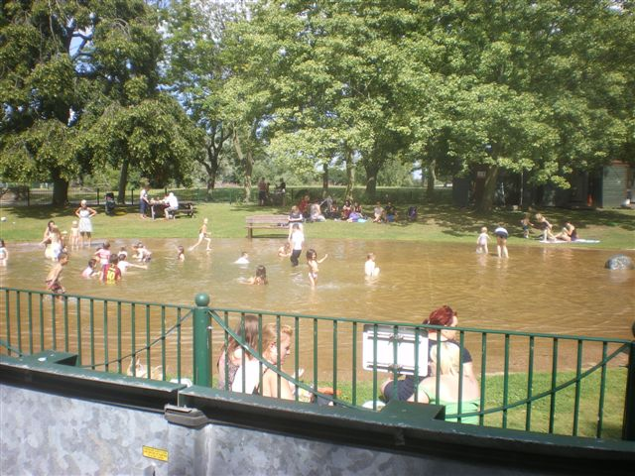
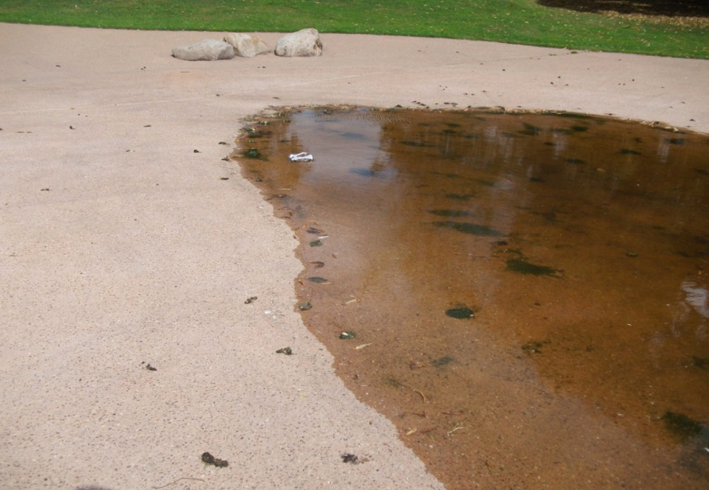
Pool Water Management
If the pool water ……..
Looks like the River Mersey
Smells like the River Mersey and
Tastes like the River Mersey
Then it probably has the microbiology of the River Mersey

Slide 31
Good design is essential to pool water quality
Effective management is essential to pool water quality
Monitoring should be carried out – by trained staff
Verification samples (for microbiology) can be taken
Samples should be tested by UKAS accredited laboratories
Normal Operating Procedures and Emergency Action Plans should link in with monitoring and verification sampling

Slide 32
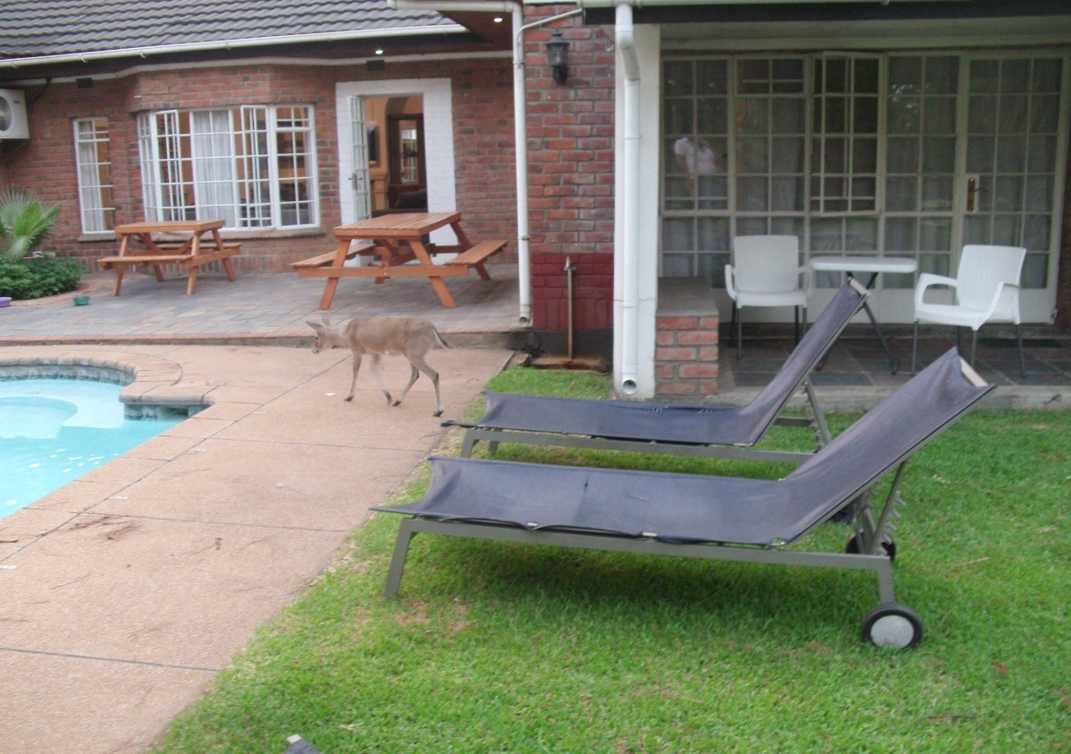
Swimming & Recreational Water
Water management involves many aspects including design, operation, training and microbiology;
Risk based assessments and NOPs/SOPs and EAPs/EOPs are essential

