Slide 1
Hygiene in the pool
The issues too difficult to talk about!
Sarah Dack, Environmental Public Health Scientist, PHE

Slide 2
Hygiene
Why we need it
What should we encourage swimmers to do
Types of incidents
The role of staff
The treatment
Incidents

Slide 3
Why Pool Operators need good hygiene
Swimming is a healthy enjoyable exercise – reduces hypertension and CPD, reduces obesity, keeps you fit
We don’t want swimmers to become ill
You don’t want pool operators to be prosecuted (criminal/civil)
You don’t want pool’s closed
Reputational Damage, Loss of Income

Slide 4

To achieve good hygiene
Good management, trained staff
Safety operating procedures (normal and emergency)
Technical operating procedures
Monitor your performance, learn from incidents
PWTAG: Code of Practice: The Management And Treatment Of Swimming Pool Water, August 2019
PWTAG: Swimming pool Water, 3rd Edition

Slide 5
Health Aspects
PHE want to:
reduce obesity,
decrease diseases associated with lack of exercise – diabetes, CPD, etc
improve mental health
Useful form of physiotherapy
Swimming can help with this
Don’t want people put off by bad experience
Or news of bad experience

Slide 6
Adult Swimmers
Use the toilet before swimming or using a hot tub & wash hands
Shower thoroughly – this removes faeces, urine, microbes, dirt, sweat, skin creams and sun tan lotion - all which may effect the water treatment
Do not swim with severe athlete's foot
Do not swim or use a hot tub after a heavy meal
Do not swim under the influence of alcohol or drugs
Do not swim if you have a fever/feel ill
Do not swim for 48 hrs if you have had diarrhoea* or vomiting
Notes:
Crypto 14 day sstill have oocysts around their anus
30 litres of clean water per bather – sweetners, urine

Slide 7
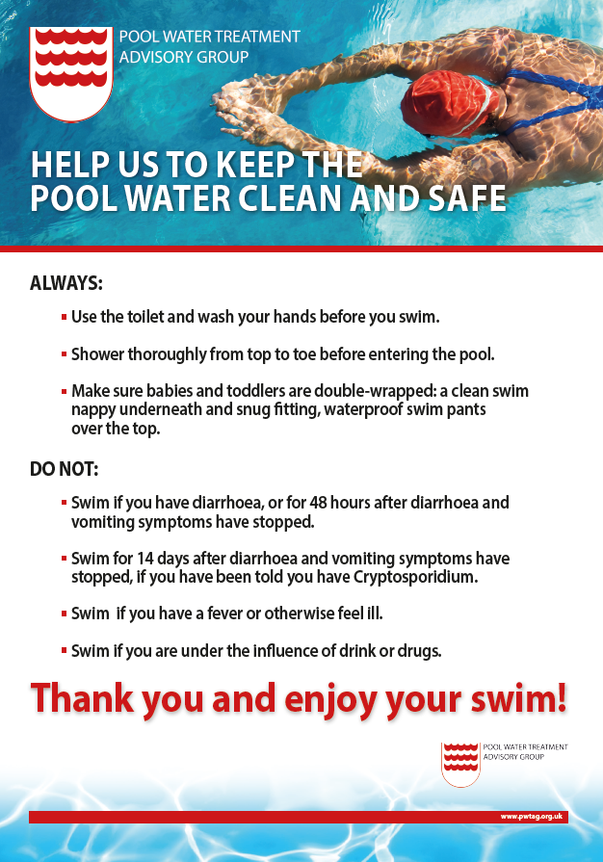
Children and Infant Swimmers
As per adults – remind them not to pee in the pool!!
Provision of separate pool
Make sure babies and toddlers are double-wrapped: a clean
swim nappy and a snug fitting, waterproof swim pants over the top
Provision for safe disposal of soiled nappies
Skin infections such as impetigo more common in children – sufferers should not swim, but this is NOT transmissible through normal pool use
Verrucas more common (regular cleaning of pool surrounds & showers)

Slide 8
Other types of swimmer
MRSA and Staphylococcus aureus sufferers can use pools
Those with MRSA contaminated skin wounds should not
People with catheter's can swim
  Urine: ATACP recommend that the bag should be emptied prior to immersion, due to the physiological effects of immersion causing urine output to increase - needs to be space for it to collect to prevent back flow. Bags are unlikely to burst and if it failed adequate water disinfection should cope.
Faeces: a colostomy bag is of potentially higher risk. Recommend that the stoma site should have an adequate seal, use waterproof dressing to assist the seal, empty the bag prior immersion and use either a support belt or tubigrip or tight swimwear to support the colostomy bag in place to prevent dislodging.

Slide 9
If you don’t encourage good hygiene
Each day an adult produces 1 litre of sweat, 1 billion skin flakes and 38g of grease, which can be added to the pool!
Mucous, saliva, hair, faeces from around anus, urine, also added.
approx 30ml of urine is released per bather (involuntary), more (70ml) if voluntary. 30ml is about 200mg of urea.
average of 950ml of sweat per swimmer per hour. About 250mg of urea.
Canadian study – 0.01% of pool water was urine.
Transfer of dirt from outside footwear, pram wheels to bare feet

Slide 10

Health Effects are Caused by:
Pool Plant not operating at optimum
Infections – most brought into pool on swimmer
Infections likely to impact others if –
slow response,
inadequate treatment,
poor maintenance,
inadequate cleaning
too high bather loading

Slide 11
Health Effects:
Gastro-intestinal issues - Norovirus, Adenovirus. E.Coli, Shigella, Enterovirus, Giardia, Hep. A, Crypto
Respiratory/fever issues – Leptospira, Legionella, Hep A, Cryptosporidium
Skin & foot irritation –
by-products such as chloramines and trihalomethanes (urea)
Athletes foot, verruca's
Bromine itch, hot tub itch, water slide rash - Pseudomonas (skin/ears/eyes), or Staphylococcus (skin)
Eye irritation -
Wearing contact lenses or don’t clean immediately after swim (Acanthamoeba)
Brain eating - Naegleria fowleri
Parasites like Bilharziasis, Schistosoma

Slide 12
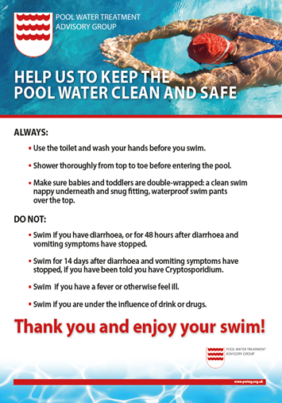
Role of Pool Operator in ensuring good health
The average pleasure bather does not know about pool hygiene in UK.
Pool operator should consider:
PWTAG poster
Signs/advice
Design of changing areas
Talk to schools ???
Maintain the pool plant and operation to optimum requirements
Act efficiently and swiftly during a possible contamination incident

Slide 13
Pool Surrounds & “Wet” Areas
Prevent infections from contact
Divide outdoor wear and pool wear areas, walked through ext. dirt
Brought in infections - verruca's, athletes foot, pool surrounds and changing room showers
Poo, blood, vomit, etc (see pool) stop it entering pool or pool side drains.
Play equipment, floats, etc encourage biofilms and bacterial growth – regular clean with free chlorine

Slide 14
Pool – Poo Events
They will happen at some point!
Mostly younger swimmers, but not always
Act quickly as soon as its identified
Pools should have written procedure (equipment/chemicals all accessible)
Staff should be trained in the procedure
Maintain faecal accident log (just in case good hygiene was insufficient)
    May be called to a HSE or multi-agency meeting

Slide 15
Pool – Solid Poo
Relatively easy to deal with
Generally unlikely that perpetrator has an acute gastrointestinal illness
immediately remove from the pool using a scoop or fine mesh net
Flush down the toilet (not put in any pool drains)
Check all have been “caught” and disposed of
If widespread the pool should be closed and treat as for runny faeces.
Equipment used should be disinfected using a 1% solution of hypochlorite.
If pool is operating properly (appropriate disinfectant residuals, pH) , no further action.
If faeces broken up, public were effected or removal took time, operators should consider clearing the pool of bathers for, 30 minutes whilst faeces are removed
Bathing should not resume until all the faeces have been removed.
Notes:
This is more an aesthetic isse

Slide 16
Poo – Runny Poo
watery, runny or soft (diarrhoea)
the risk of infection is greater - more likely to be caused by enteric pathogens (viruses, bacteria or protozoa)
Other causes: alcohol, emotion, diet, medicine side effects, but cannot assume.
Try asking the perpetrator (if known), or manager may know if local outbreak
Impossible to catch with scoop or net
E. coli, Shigella, norovirus, etc, killed within minutes in normal disinfected pool, Giardia killed in 45 mins.
Oocysts of chlorine-resistant protozoa Cryptosporidium, take 10 days to be killed.
Notes:
Giardia takes 45 mins, E coli less than 1 min in chlorinated water
Crypto 10 days
Assuming 1 million oocysts per gram of diarhea in a typical 45m x 12m pool
children aged 6-18 years consume 37ml of pool water in a training session, so would swallow 12 oocysts

Slide 17
Cryptosporidium
Assume 1 million oocysts per gram of diarrhoea
They can be found around anus for 2 weeks post infection
Release in a typical 45m x 12m pool
Assume children aged 6-18 years consume 37ml of pool water in a training session;
The children would swallow 12 oocysts
1 oocyst can cause infection

Slide 18
Poo – Runny Poo
Remove all bathers - if they move from a children’s pool to a main pool, they should shower first using soap and water.
young children are both the likeliest sources of the infection, and those worst affected (along with the immunocompromised).
If diarrhoea - will not know if Crypto, so have to assume the worst
  three procedures that will in time remove Crypto – coagulation/ filtration, UV and superchlorination. Depends on the efficiency of the pool’s filtration.
  If have evidence not crypto then clear bathers for 30 mins, increase disinfectant residuals to the top of the set range and pH at minimum.

Slide 19
Diarrhoea – if watery definitely assume the worst!
Depending on type of filter
Coagulation with long enough residence to allow flocculation to occur
Filtration
superchlorination
Vacuum and sweep pool
Backwash filters
Notes:
Oocyxts shed from anus up to 2 weeks after infection
A million per gram of poo

Slide 20
Pool - Blood or Vomit
Blood & Vomit less likely to cause illness as faeces
Pool disinfectants should be enough to kill anything present
Nose bleeds – quickly dispersed & anything killed
Significant blood loss – temporarily clear pool, allow blood to disperse
Check disinfectants/pH is at correct operating range
If on pool side wash down, but not into pool or pool side drains
Notes:
Aesthetic generally could include Hep A, C, HIV or crypto, but generally unlikely – only a problem if gets into cuts

Slide 21
Pool - Blood or Vomit
Vomit 1: may be due to swallowing water or over exertion. Clear the pool of bathers, scoop up vomit and allow to disperse. Confirm that disinfectant residuals and pH values are within the recommended ranges; bathing can then resume
Vomit 2: containing the contents of stomach, indicates a swimmer is ill and may be infected with Cryptosporidium. Take exactly the same course of action as would with runny stools or diarrhoea.
The safest action, if the incident has occurred in a small pool or hot tub, is to empty and clean it before refilling and reopening.

Slide 22
Outbreak procedures
A good, well maintained pool SHOULD not have a outbreak
An outbreak involves 2 or more people
An outbreak is rare
The pool should have an outbreak procedure and emergency action plan
Outbreaks usually transient
More children in summer = more chance of Crypto !!
You will be involved with MA team – LA’s, PHE, possibly HSE, etc
Source could be Faecal or vomit release, but generally inadequate filtration, disinfection, cleaning, backwash problems, ie MANAGEMENT
Notes:
PHE have procedures in place ofr infection control

Slide 23
Incidents
Inadequate management or design 2015+
Low disinfection levels so can dye water – 16 norovirus cases, Kent
Low disinfection levels so can dye water – 68 norovirus cases, Warwickshre
Untrained pool operator – chlorination incorrect – 219 Giardia cases, York
Water park – too high bather load – “dozens” norovirus, Leicestershire

Slide 24
Outdoor Pool – Health effects
Potentially more protozoa and bacteria
Animal faeces, birds faeces, drowned animals
Dust, windblown dirt, litter
  Super chlorinate, filter for a day
  Filter backwashed then circulate over night
  But better than open water swimming - not considered to be of bathing quality as it can contain sewage, livestock contamination, and pollution from farming or industry.

Slide 25
Dogs – in public pools
Not against animal hydrotherapy – don’t mix with public!
More faeces, hair, urea and grease than human
Can carry diseases and parasites like Toxocara
Difficult to assume correct bather load (& treatment) compared to humans
Difficult to clean sufficiently; a dog hydrotherapy pool has a fur filter
Should treat like runny poo incident
    But – make sure you haven’t clogged filters!
Notes:
Toxocariasis is a rare infection caused by roundworm parasites
In rare cases, the roundworm larvae infect organs such as the liver, lungs, eyes or brain and cause severe symptoms – vision loss, fatigue seizures
As can survive in soil, even if you worm pets they might have them on their feet.

