Slide 1
SPATEX 2020
Swimming Pools and European Standards Post BREXIT
Chris Hayes

Slide 2
Chris Hayes
Managing Director – BSPF, BISHTA & SPATA

Slide 3
Session Overview
What are European standards and which ones do we have?
What impact does BREXIT have?
What happens next?
Any questions?

Slide 4
What are European standards?
European standards are technical specifications defining requirements for products, production processes, services or test-methods.

Slide 5
What are European standards?
European standards are technical specifications defining requirements for products, production processes, services or test-methods.
In practice, they allow for harmony across the EU and some other areas of Europe for manufacturers, etc. trying to sell into the market (from within the EU or elsewhere in the World)

Slide 6
What are European standards?
European standards are technical specifications defining requirements for products, production processes, services or test-methods.
In practice, they allow for harmony across the EU and some other areas of Europe for manufacturers, etc. trying to sell into the market (from within the EU or elsewhere in the World)
European Standards are overseen by CEN or CENELEC
- European Standards are subservient to Laws & Regulations
- European Standards take precedence over national guidelines

Slide 7
What European standards do we have?
Below is a small list of the numerous European standards (BS EN’s) that have a direct impact on our industry:
Commercial (public) pools
1069 (2 parts), 13451 (9 parts), 15288 (2 parts)
Domestic pools and spas
16582 (3 parts), 16713 (3 parts), 16927 and 17125
Generic items
1992-3, 15836 (2 parts), 20+ pool & spa chemical standards

Slide 8

What European standards do we have?
BS EN 15288
Part 1 deals with Design
Part 2 deals with Operation

Slide 9
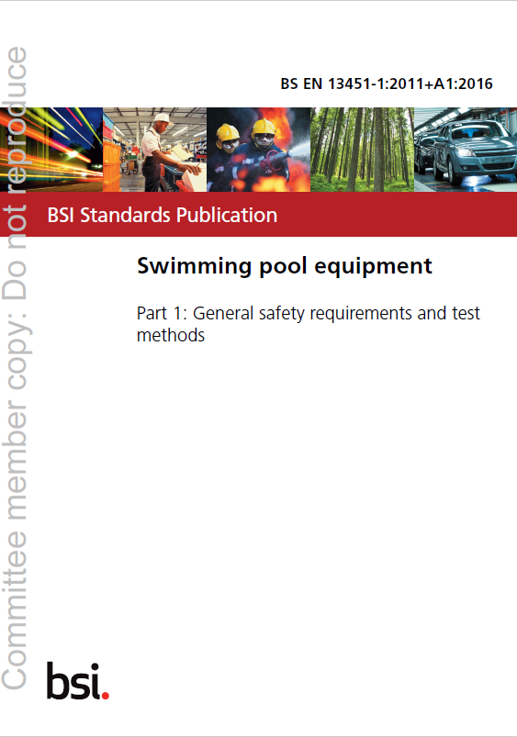
What European standards do we have?
BS EN 13451
9 parts to these swimming pool equipment standards
Part 1 looks at safety requirements and test methods:
Entrapment issues
e.g. permissible openings & hair entrapment

Slide 10

What European standards do we have?
BS EN 16582 (in 3 parts)
Watertightness classifications
The importance of recommending safety protection devices
and the importance of safety signs

Slide 11
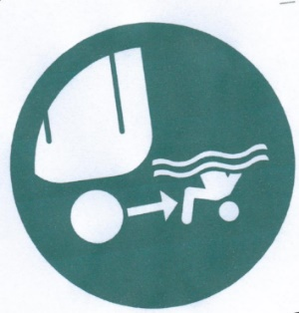

Safety Signs for domestic pools
All Swimming pools should be provided with:
Warning Signs –
  “Children must be supervised at all times in the aquatic environment”
  “No diving”
  Instruct client to fix signs within 2,000mm of the pool in a prominent visible position

Slide 12
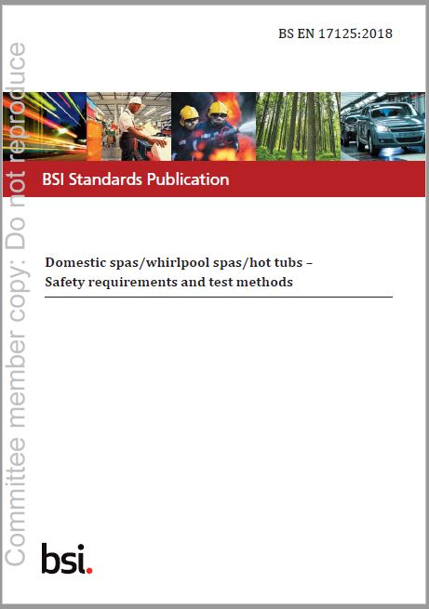
What European standards do we have?
Domestic spas, hot tubs and whirlpool spas
Defining types of spas e.g. Scandinavian Hot Tubs
Water treatment advice, where applicable

Slide 13
What European standards are being developed?
Examples of some of the European standards currently under development:
Commercial wellness
Spas, sweat rooms (saunas)
Domestic pools
Environmental impacts

Slide 14
What European standards are being discussed?
Although not close to be agreed yet, there is ongoing discussion about having minimum standards across Europe for the treatment of public swimming pool water.

Slide 15
What impact does BREXIT have?

Slide 16
What impact does BREXIT have?
As it currently stands, the European Union (Withdrawal) Act 2019 should see little, or no impact on the use of, development and / or revision of European standards, as they are industry guidance, not EU regulations

Slide 17
What impact does BREXIT have?
As it currently stands, there should be little, or no impact on using the European standards as they are industry guidance, not EU regulations
There will continue to be official versions of European standards in English, French and German

Slide 18
What impact does BREXIT have?
As it currently stands, there should be little, or no impact on using the European standards as they are industry guidance, not EU regulations
There will continue to be official versions of European standards in English, French and German
The UK government will still recognise these standards (just as another 6 non-EU countries already do):
- Iceland, North Macedonia, Norway, Serbia, Switzerland and Turkey

Slide 19
What impact does BREXIT have?
As it currently stands, there should be little, or no impact on using the European standards as they are industry guidance, not EU regulations
There will continue to be official versions of European standards in English, French and German
It is expected that the UK government will still recognise these standards (just as another 6 non-EU countries already do):
- Iceland, North Macedonia, Norway, Serbia, Switzerland and Turkey
Opportunities remain for new British standards, if required

Slide 20
What happens next?
The UK leaves the EU on 31st January 2020 at 11pm (tomorrow)!

Slide 21
What happens next?
The UK leaves the EU on 31st January 2020 at 11pm (tomorrow)!
A transition period to negotiate a trade agreement between the UK and the EU will run from this date of exit until 31 December 2020

Slide 22
What happens next?
UK leaves the EU on 31st January 2020
A transition period to negotiate a trade agreement between the UK and EU will run from the date of exit until 31 December 2020
When the UK leaves the EU there may be changes to the requirements for placing certain products on the UK and EU markets where they are affected by Regulations

Slide 23
What happens next?
BSI remains a key player in CEN and CENELEC (ISO and IEC unaffected)

Slide 24
What happens next?
BSI remains a key player in CEN and CENELEC (ISO and IEC unaffected)
UK experts will still be asked to help to develop new standards and revise existing ones (both in Europe and on mirror committees in the UK)

Slide 25
What happens next?
BSI remains a key player in CEN and CENELEC (ISO and IEC unaffected)
UK experts will still be asked to help to develop new standards and revise existing ones (both in Europe and on mirror committees in the UK)
The relevant UK mirror committees including SW 136/8 will need to continue meeting, in order to have the UK voice heard in the European committees

Slide 26
Summary

Slide 27
Summary
European standards are very important to follow, as they are industry guidance
If you do not follow the guidance you should have robust reasons why you do things differently (at least equivalent or ideally better)?
BREXIT should have little, or no impact on European standards
Whatever change BREXIT brings, keep up to date on industry standards and guidance

Slide 28
Any questions?

Slide 29
Thank you for your attendance

