Slide 1
Legislation-Training and the PWTAG Code of Practice
How to make it work effectively
Presented by- Ian Nicks-Institute of Swimming member of PWTAG Council

Slide 2
Legislation and HSG 179
HASAWA 1974
Place mandatory responsibility on Employers and Employees
This is formalised as an industry guidance in the Document known as -HSG 179(3rd edition)
The responsibilities are principally that an Employer has a duty to provide training-instruction-information and supervision
Training will be suitable and sufficient and will be monitored/reviewed
Employees have a duty to take part in training and co-operate with the Employer
The industry accepts this!!
So why does it appear to be so divisive and problematical to implement..

Slide 3
Legislation
In order to comply with legislation, there has to be generic and on site training to ensure that the aims are achieved in regard to the above.
Some insurance companies WILL NOT insure organisations which do not comply with the legislation.( I am dealing with one of these at the moment!!)
There are numerous case studies where this has been seen to be the case.
HSG 179 gives the organisation the information to achieve this and recommended in the document ,that pools contact PWTAG for guidance with all pool related matters, so the HSE actually approve PWTAG as the technical body.
7 The document gives management advice and technical information on health and safety in swimming pool design and pool water treatment. The information on swimming pool design and pool water treatment is only an introduction to these topics. For more in-depth technical information, you should refer to the specific industry guidance listed below:  The Pool Water Treatment Advisory Group (PWTAG) Code of Practice (www.pwtag.org);  The Swimming Pool Water Book (www.pwtag.org);  PWTAG Technical notes (www.pwtag.org);  The European Standard EN 13451 Swimming pool equipment (Parts 1–11);
Page 4 HSG 179
The 1999(updated) regulation also reinforces this through Risk Assessments and duty of care.

Slide 4

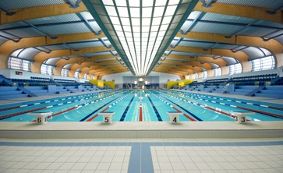


Code of Practice
THE MANAGEMENT AND TREATMENT OF
SWIMMING POOL WATER
Pool Water Treatment Advisory Group
2019
The blue book from PWTAG
PHE/HSG 282--2017
HSG 179
!!!!!!!!!MUST HAVE GUIDELINES!!!!!!!!!!

Slide 5
Poor Examples!!!!
The following slides should make us all wince with embarrassment
They are real slides mostly taken by me at either inspections or call outs for chlorine spillages!!!
BUT they are still happening

Slide 6
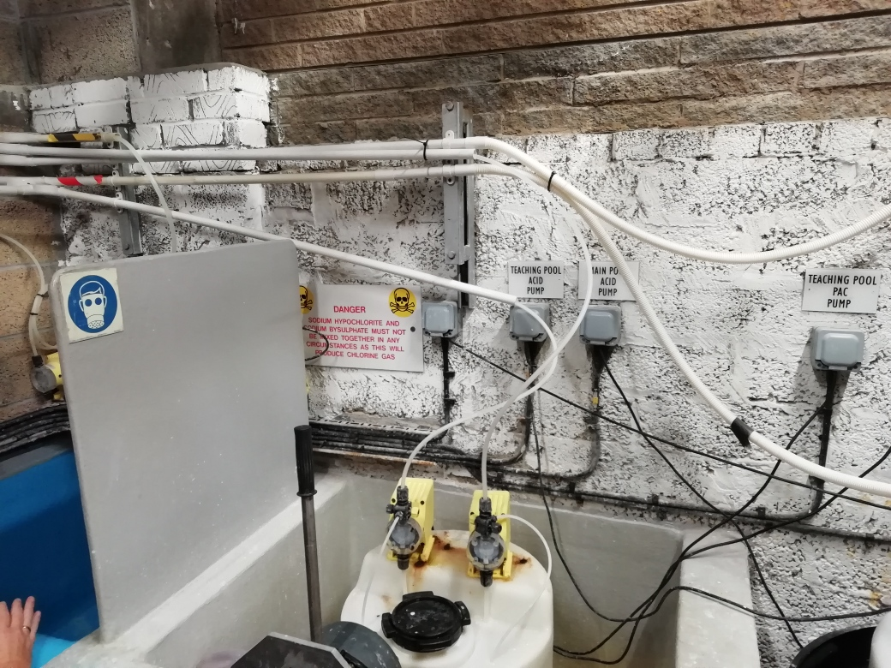

Slide 7
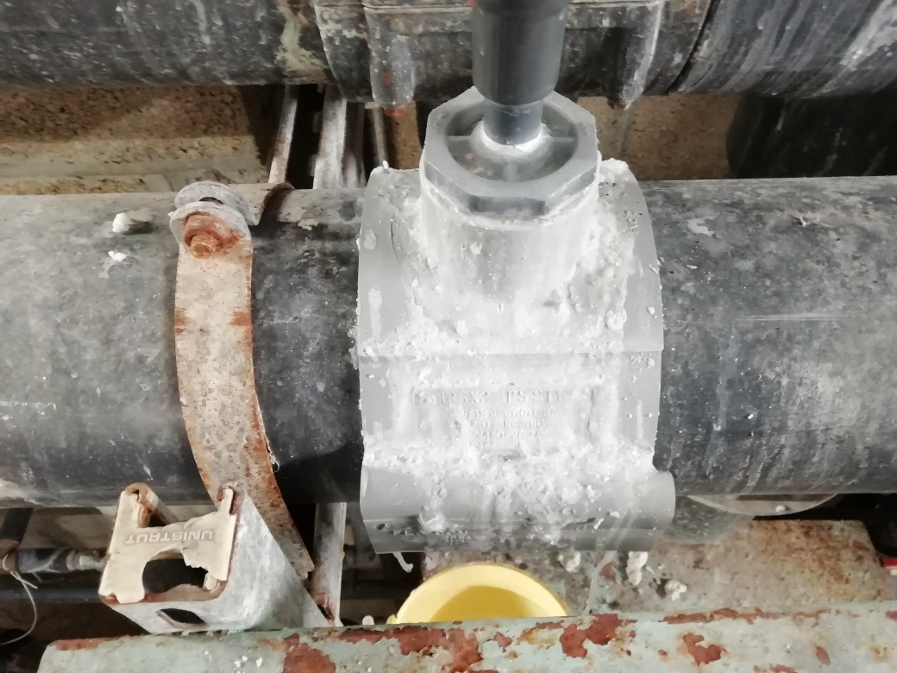

Slide 8

Two firms fined over toxic spill at Staffordshire gym
Two firms responsible for a chemical spillage at a Staffordshire gym and pool which left eight people needing hospital treatment have each been landed with a court bill of almost £60,000.
Firefighters at the scene of the chemical spill at Nuffield Health Wellbeing’s pool in March 2009
Four children were among those hospitalised for breathing in toxic chlorine gas at a Hednesford pool.
The incident happened at Nuffield Health Wellbeing’s pool in March 2009, just a few months after the company had taken over the former Cannons Health Club in East Cannock Road.
Nuffield Health Wellbeing and Honeywell Control Systems, who maintain the pool machinery, were each fined £45,000 at Stafford Magistrates Court. Each had to pay court costs of £14,754.
The court heard yesterday how swimmers started coughing and crying and struggled to breath. The building was evacuated and the fire service called.
Mr Barry Berlin, prosecuting on behalf of Cannock Chase District Council, described how distressed parents saw their children’s lips turn blue and had to be given oxygen at the scene.
Mr Berlin said Nuffield employed Honeywell to maintain the pool plant room, and on the day of the incident, engineer Allan Dean had mistakenly poured sodium hypochlorite into the sodium bisulphate, which caused the escape of the chlorine gas, which “presented a significant risk to people’s health”.
However due to the quick action of the staff, “serious injury was reduced”.
Mr Berlin said the pool had “shoddy practices.”
Both companies admitted three offences and apologised and said they had improved all services.

Slide 9
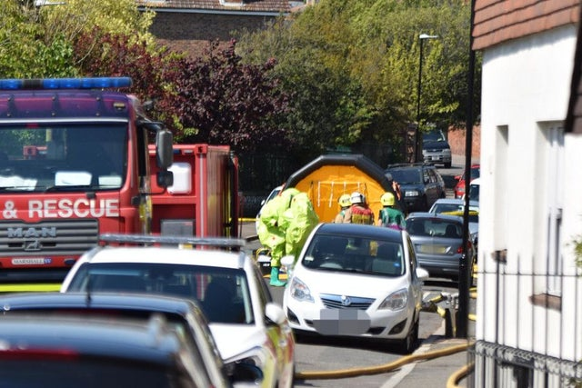
Incidents
Staff working to re-open Motcombe swimming pool after chemical leak
Fire-fighters are clearing up the scene at Motcombe following a suspected chemical leak at the pool.

Slide 11
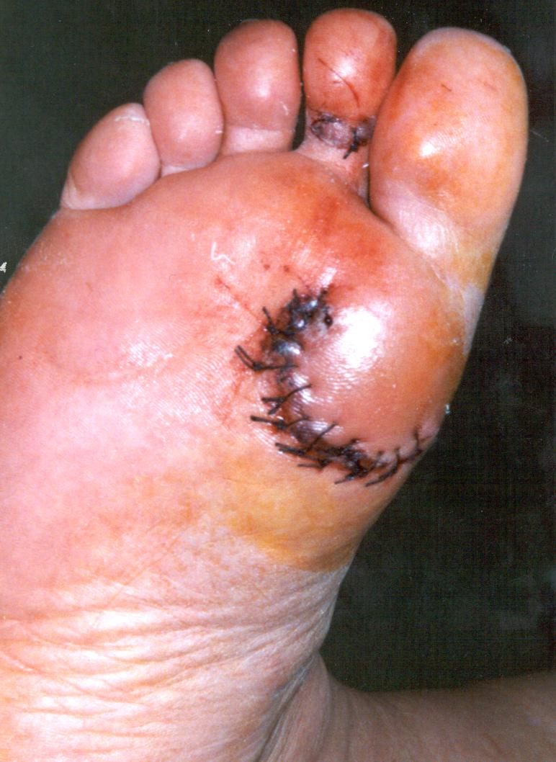

Slide 12
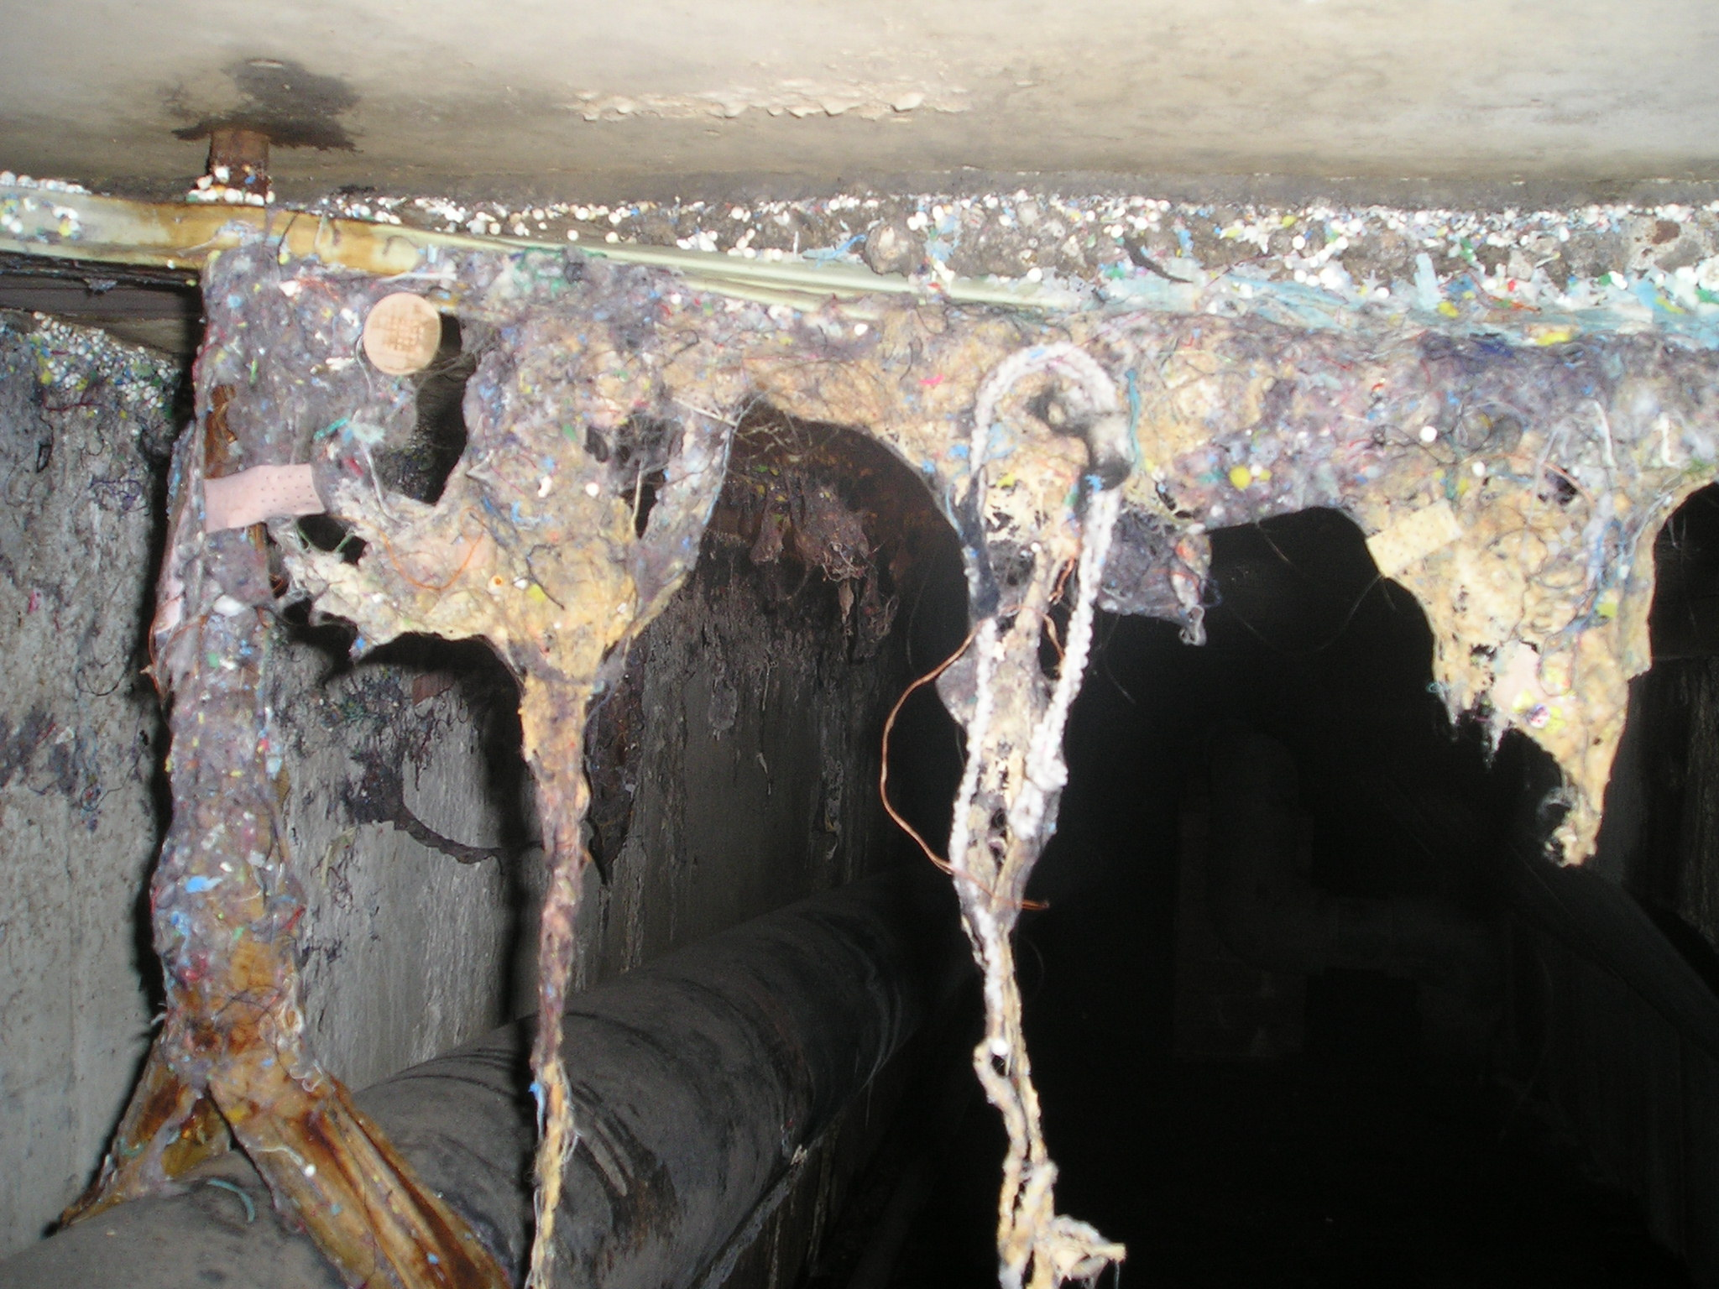

Slide 13
Problems
Our industries biggest problem is that organisations just do not take this seriously especially and without prejudice some of the private sector.
In 2019 through the summer, there were 4 incidents within our sector which required Emergency Services to be called to our premises. I was involved(and still am) with one of these which will lead to a prosecution of the pool operator, evidence from the Pool Water Book and Code of Practice to back up the statements will be invaluable.
There were issues regarding, no training records-systems of work-clear operation procedures-and most importantly no senior management structure to follow.

Slide 14
Training
Training should be suitable and sufficient and regularly monitored.
In my previous career this was known as TPR(Temperature-Pulse and Respiration!)
In my career now I call it (Training-Performance-Review)
This involves a thorough process of achievable outcomes which should be measured(smart) and records should be kept for external inspection if needed.
Records include, skills cards-sop`s-reviews-qualifications-renewals
SDS- and COSHH assessments-updated NOP and EAP signed off
HSG 65 states that training should be auditable with each step measured alongside the organisations plan for health and safety—WHAT PLAN!!
Any variation should be reported and recorded for rectification within the given time period.

Slide 15
Code of Practice-PWTAG
PWTAG Code of Practice is recognised as the Industry Guidance! And is accepted as such by the HSE
Just as the Highway Code is recognised with DSA and accepted under the RTA
Although failure to comply with the other rules of the Code will not, in itself, cause a person to be prosecuted, The Highway Code may be used in evidence in any court proceedings under the Traffic Acts
PWTAG-COP IS THE INDUSTRIES RECOGNISED AUTHORITY FOR POOL WATER AND PLANT OPERATIONS
Operators can be trained by any competent person-but who is judged as competent to train staff-otherwise there would not be trained teachers in schools!! If anyone could do it!
Did your Dad teach you to drive!!!!!
In 2003,PWTAG engaged BSI to write PAS 39 which was never publicised enough-yes a criticism! ,but what it did, was to set standards of pool operation which had been lacking, as a document it paved the way for training to form part of the operators duties.
When this document came up for renewal, PWTAG replaced it with the Code of Practice which is now updated as required.

Slide 16
Code of Practice
Now we have the standard which has been set and is approved by HSE through HSG 179.
The latest edition August 2019 details the requirement for a PTOP and details re training-reviewing and monitoring.
What we have done to further enhance this is to invite training organisations to become accredited to the COP and thus increase the level of training in the industry-THERE HAVE BEEN OBJECTIONS.
However, we now have 4 accredited organisations including my own(IOS)at present who carry out most of the training in the UK and around the world, are delivering training from materials and assessments which match the COP(PTOP) and in turn will satisfy HSE should an incident occur.
Within the COP there is an explanation for attainment of POOLMARK by adopting what is called-PTOP-this is not new to some pools but is enhanced by any pool operation matching this standard.
Remember BS5750-I was involved many years ago with Peter Mills-which then turned into Quest which sadly does no longer go into the depth of the plant room operations.

Slide 17
Code of Practice
The document also brings in the latest thoughts on pool operation as well as training.
Examples:
Turbidity through the measurement of Sulphates, flow meters,
Validity of efficiency of Ultra Violet installations
Protocols for Crypto procedures with regenerative filters
IT IS FREE TO DOWNLOAD!!!!
Scope of records to keep such as:

Slide 18
Record keeping—PTOP-examples
NOP/EAP
Microbiological results-external details and testing to confirm levels
Calibration of Testing Equipment
Test kit instructions
Details of any service contracts and work carried out
SOP for each plant room task-backed up with skills cards
SDS and COSHH assessments
Training records-certifications for inspection
Alarm(Cl2,CO2) monitoring and service intervals
Any previous audit reports

Slide 19
Summary
In today`s world it is too easy for organisations to fall into the legal mire with litigation against them—I know for a fact!!-I deal with it more and more.
Legal experts love to have definitive documents they can defend or prosecute with!
The PWTAG COP –through POOLMARK will at least show how to present the documentation for any legal (HSE,EHO) officer to follow and to stress the need for regular thorough training on site by competent professional operatives.
THE POOLMARK award will help to achieve this
It finally gives a platform for training and the level expected for a Pool Plant Operator

Slide 20
THANK YOU

