Slide 1
Hot Tubs for Business
SPATEX 2020

Slide 2
SPATEX 2020
Howard C.C Gosling
BSc(Hons), MRSC, CBiol, MiBiol, FRSPH, FPWTAG FWMSoc, FISPE, CEDR Accredited Mediator
Dangerous Goods Safety Advisor
Road Certificate Number 2849533/010130
DG Master for Sea – IMDG Code
Nether Compton Nr Sherborne Dorset DT9 4PZ UK
Email: howard@poolandspaadvice.co.uk
Web site: www.poolandspaadvice.co.uk
Tel: +44 1935 389069
Fax: + 44 1935 815699
Mobile: + 44 7860 330311

Slide 4


Slide 5
The Pool Water Treatment Advisory Group has been publishing books for 22 of its 34-year existence. But that is really only two titles – Pool Water Guide (1995) and its sequel Swimming Pool Water (latest best-selling edition 2017). Swimming Pool Water has a chapter on spas, but we felt there was a need for guidance on hot tubs tailored quite carefully and specifically to its operators. Thus this book.
Hot Tubs for Business is the first of a series of three books about spas that PWTAG is publishing (commercial spas and domestic spas to come). We wanted to get this one out first, as domestic-style hot tubs – perhaps badly chosen or installed, poorly maintained or wrongly used – can be lethal, especially when they are used for business purposes. There have been a number of outbreaks of illness, including fatalities, linked to hot tubs in holiday park rental units, hotel bedrooms, holiday lets, on hire and even on display.

Slide 6
This book is presented in the clear and definitive fashion that the many thousands of readers of PWTAG’s Swimming Pool Water have appreciated over the years. Anyone operating, or contemplating installing hot tubs as part of a business activity will need this book if they want to be both safe and up to date with the latest guidance.
In preparing this book, we have drawn on the expertise of our increasing band of members. Council members are listed. And we have had invaluable technical support from our Industry and Training Forums, detailed on page 55.

Slide 7
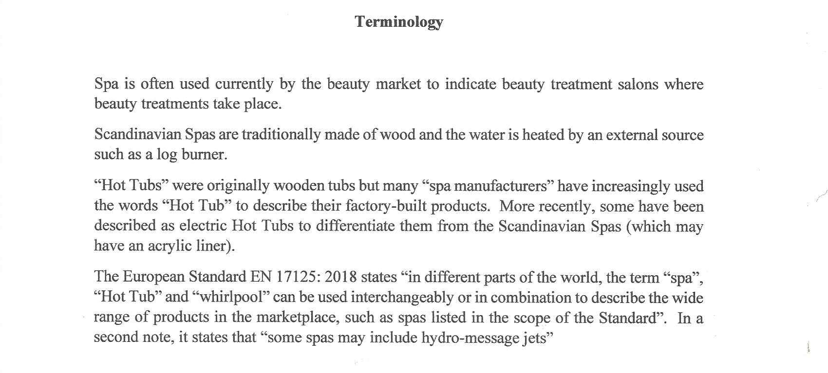

Slide 8
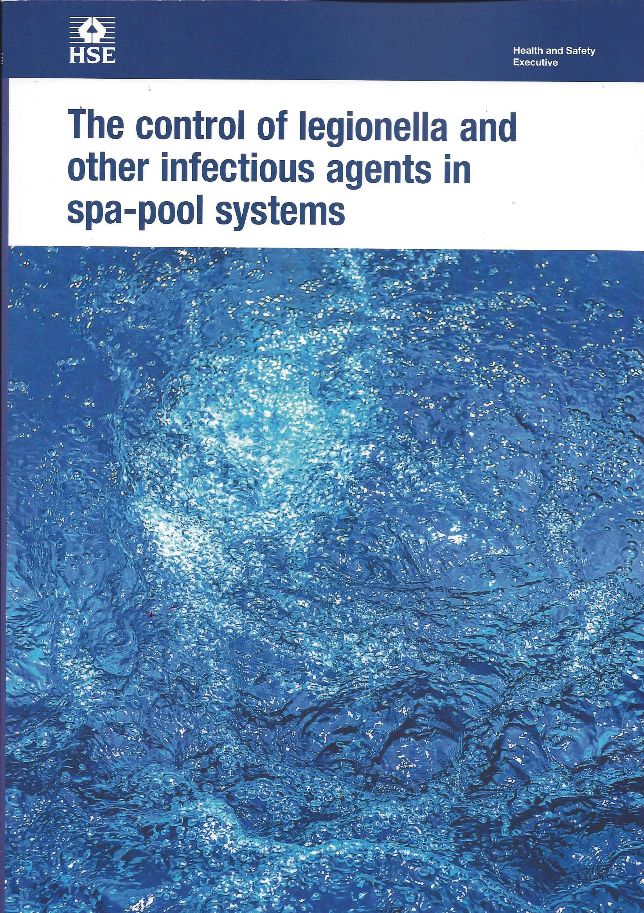
The book (HSG 282) is now available as an option as well as online

Slide 9

HSG 282
£18.00

Slide 10
Risk Assessments:
Govern everything you do.
You must have an NOP.
You must have an EAP.
Review these regularly
Ensure your Risk Assessment is suitable and sufficient

Slide 11
Risk Assessment Record Keeping
Written Risk Assessments need to be kept whilst current, and for 2 years after they cease to be current.

Slide 12
European Standards
BISHTA has worked with BSI and European colleagues to establish European Standards for Spas and Hot Tubs.
TC 402: WG 4 has produced EN 17125 covering domestic Hot Tubs in a Business setting as an Annexe.

Slide 13
European Standards –
EN 17125: 2018
Domestic spas, whirlpool spas and Hot Tubs
Safety Requirements and Test Methods
Electric Hot Tubs
Scandinavian Hot Tubs
Includes Appendix for Hot Tubs for Business
Will be reviewed again after 5 years

Slide 14
HSG 282 Section 2b - Settings
Domestic - privately owned
Domestic – installed and used as part of a business activity
Commercial – installed in a commercial establishment or public building
Healthcare

Slide 15
BISHTA Standards
Standards were reviewed and updated in 2010 and incorporated the advice from HSE/HPA Management of Spa Pools book.
Standards have been reviewed in the light of HSG 282 (taking account of errors etc therein) and was issued first quarter of 2019.
BS 8580:-1 2019 Risk Assessments for Legionella Control:
Ensure your Risk Assessment complies, and review it regularly when necessary, ensuring it is suitable and sufficient.

Slide 16
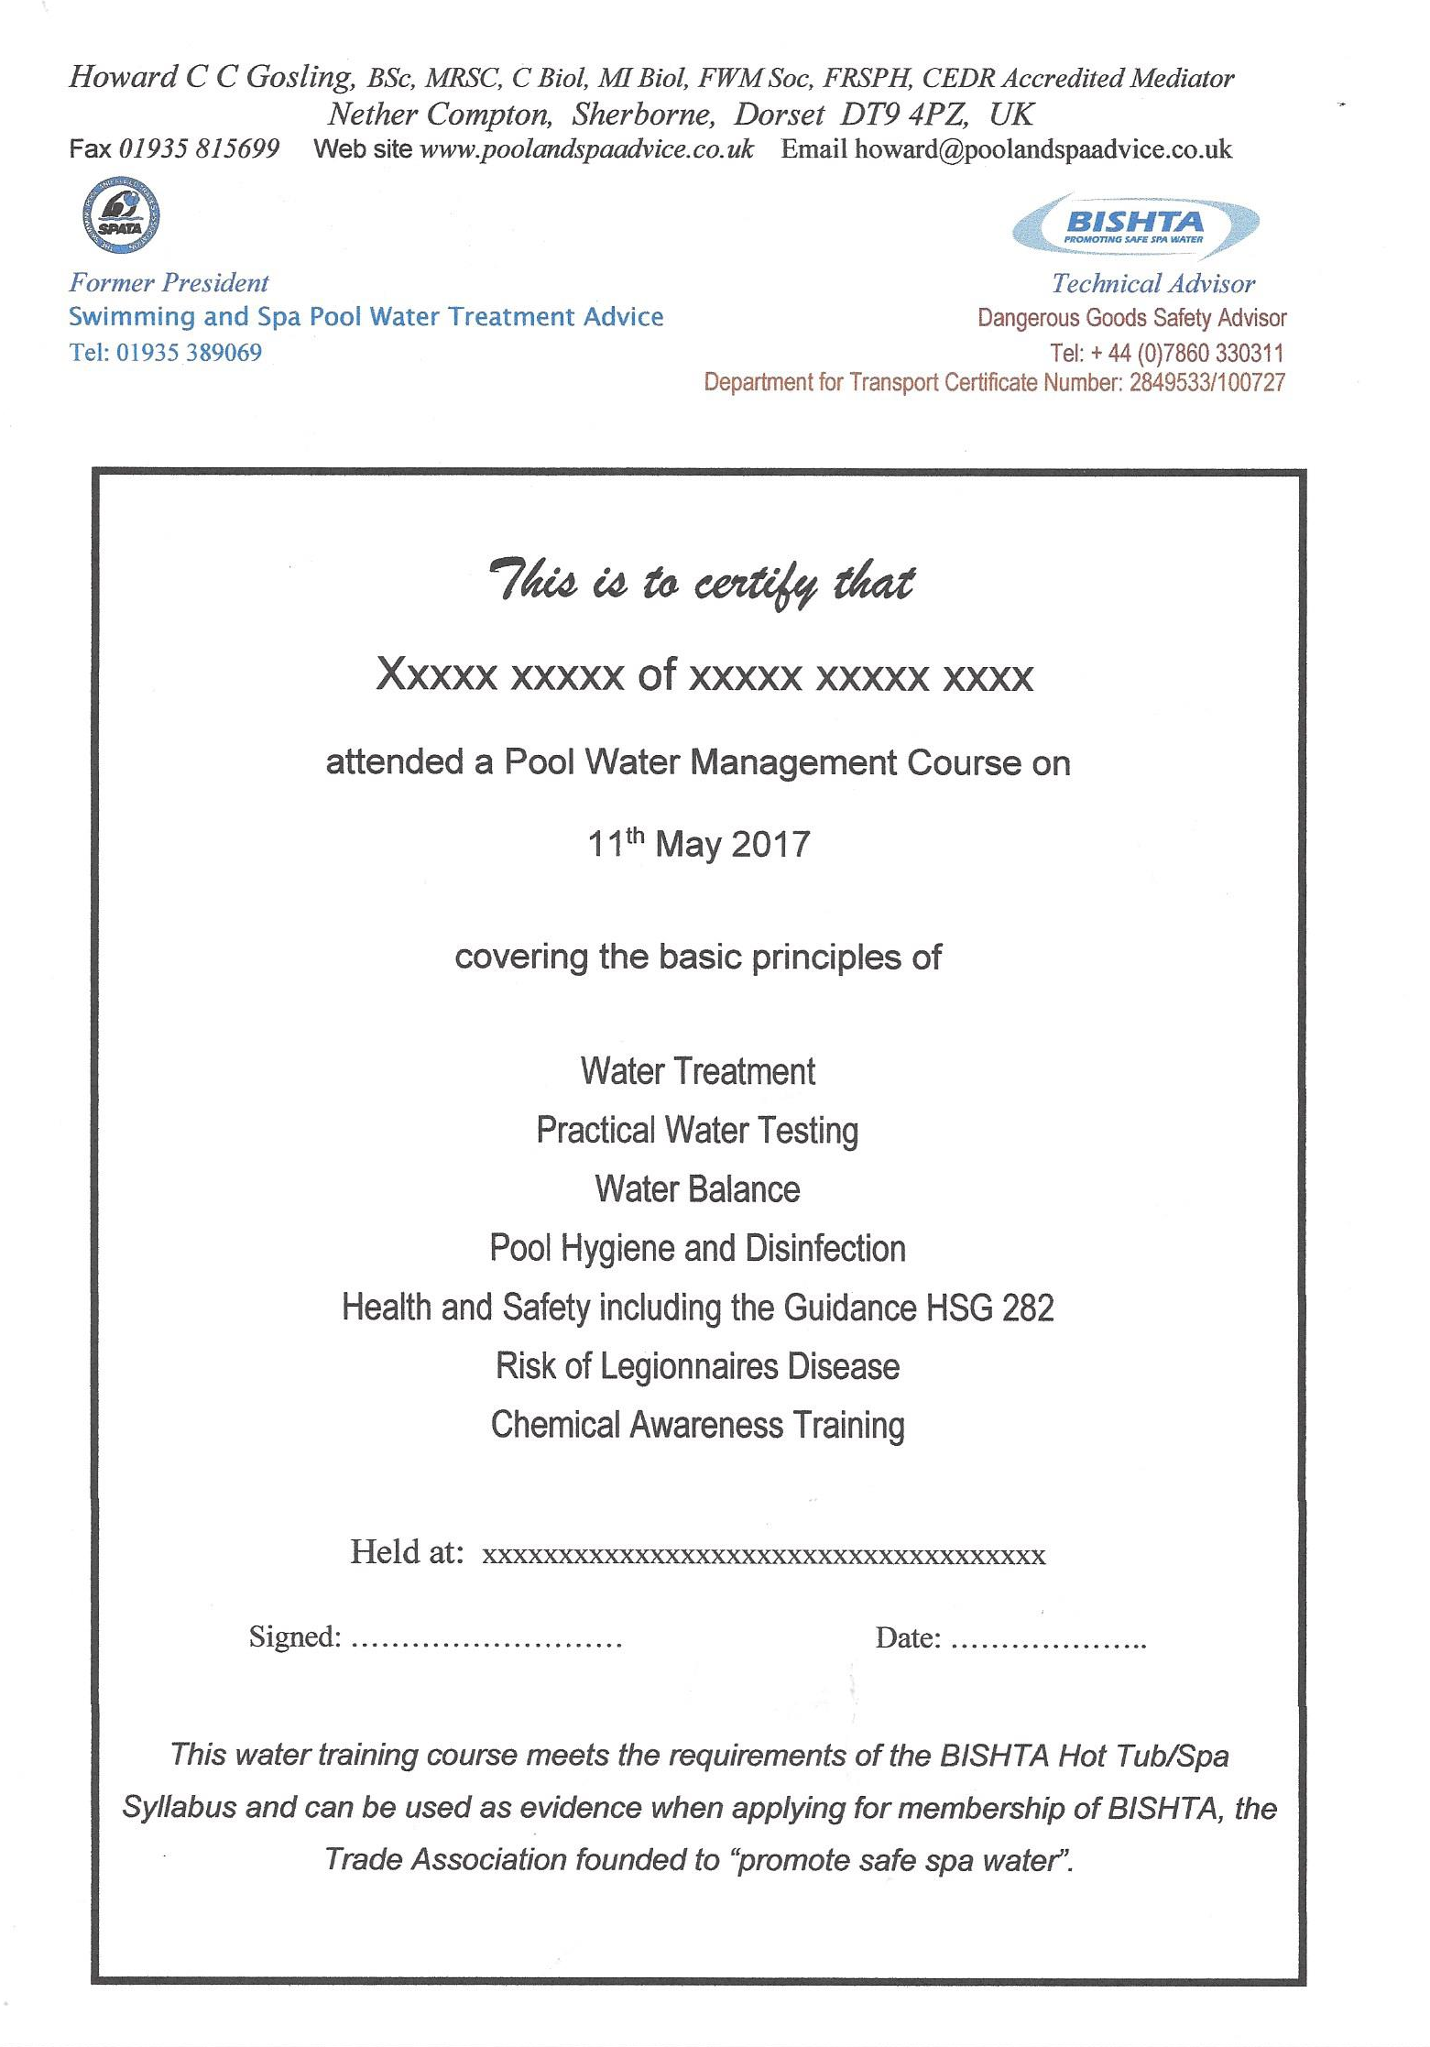
Any certificates pre 2015 now need updating by attending another one day training course.

Slide 17
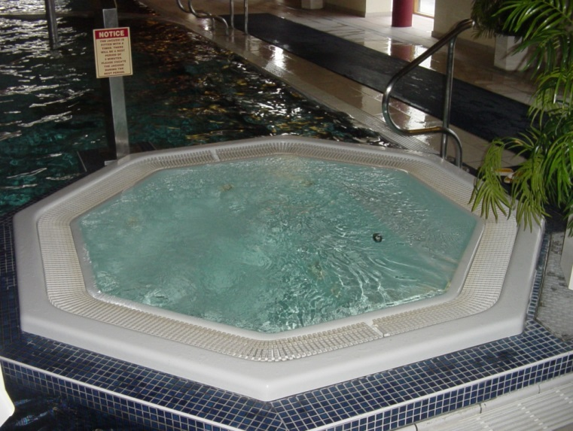
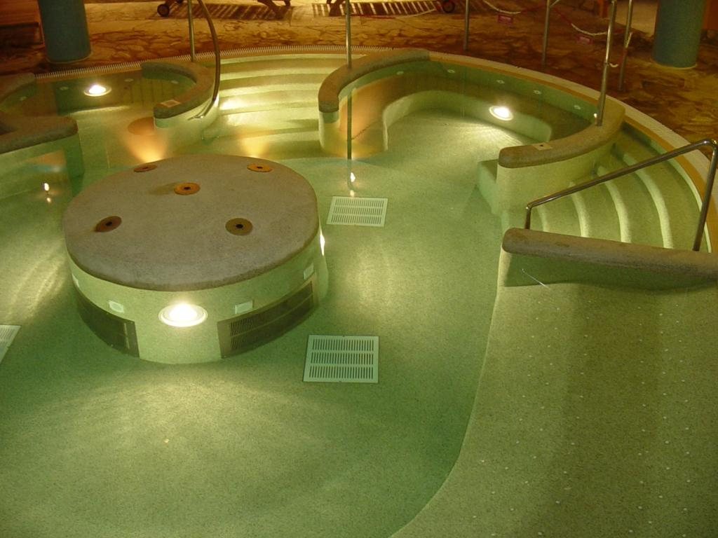
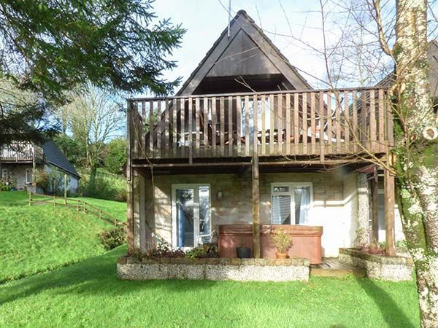
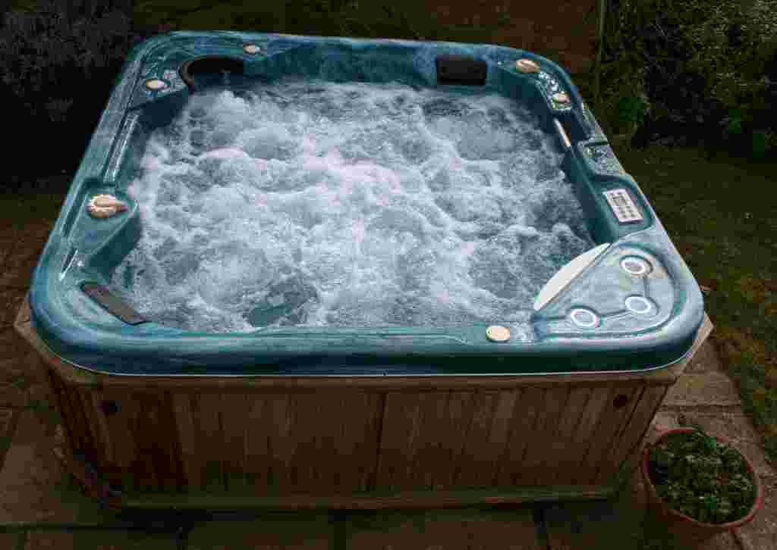
Spa
Illustrations

Slide 18
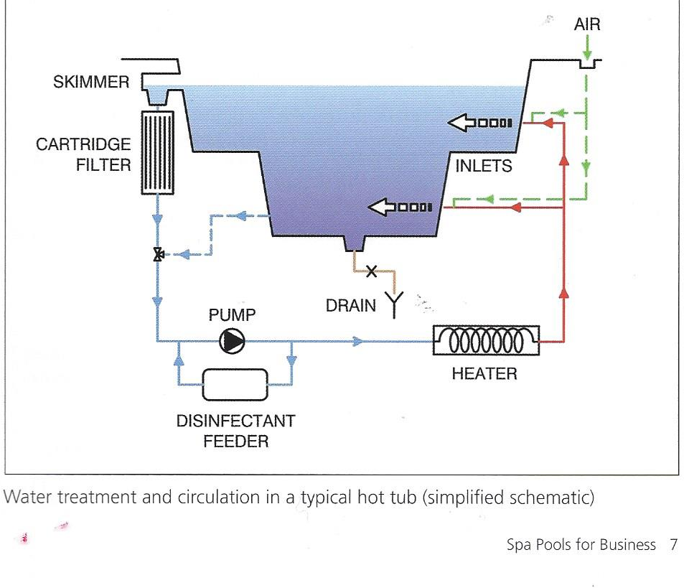
Hot Tub Schematic

Slide 19
HSG 282 - Guidance
This 2017 Guidance is primarily for those who manage or operate spa-pool systems and explains how to manage and control the Risk from Legionella and other infectious agents. It all helps service suppliers, designers, manufacturers, importers, suppliers and installers of spa pool systems to meet their legal responsibilities.

Slide 20
HSG 282
This HSE publication omitted a lot of the information previously included in Management of Spa Pools, which was a joint publication of Health Protection Agency – now Public Health England – and HSE.
Those omissions have been updated where necessary together with other advice based on experience and is included in Hot Tubs for Business

Slide 21
Health & Safety Law ?
HSE L8 contains the Approved Code of Practice as well as Guidance on Regulations.
HSG 274 Part 2 covers Showers, which should always be used before entering the Hot Tub, having already used the lavatory.

Slide 22
Scandinavian Hot Tubs
Not specifically mentioned in HSG 282
Included in European Standard EN 17125
No disinfection, pump, or filter.
Only to be used for five hours (including heating time) when filled with potable water, then need to be drained and cleaned. Refilled only prior to heating and use.

Slide 23
Microbiological Monitoring
Detail in paragraph 082 of Hot Tubs for Business
The fact that the water will have been thrown away before you get your microbiological results does not matter as what you are trying to find out is whether your disinfection and cleaning regime is satisfactory.
Paragraph 089 advises how to interpret the results.

Slide 24
Basic Factors Affecting the Quality of Hot Tub Water
Physical Factors
Chemical Factors
Biological Factors
Notes:
The three basic factors of water care are:
Physical
Chemical
Biological
In the time we have together, we will discuss each of these in depth and how you can manage them properly.

Slide 25
Chemicals Used for Sanitising
Chlorine
Bromine
Others?
Notes:
What are common chemicals used for disinfection?
Chlorine - is the most frequently used.
Bromine - is gaining more widespread use.
Biguanide - PHMB - has also been used over the past several years.
Others such as ozone and ionizers.

Slide 26
Chlorine Standards
 | SPATA | BISHTA
 | Commercial Spas | Domestic Spas
Inorganic | 2.0 – 4.0 | 2.0 – 4.0
Organic | 3.0 – 5.0mg/l | 3.0 – 5.0mg/l
Combined chlorine residual should ideally be zero but certainly less than half free chlorine residual
Notes:
Chlorine is the most widely used sanitizer for pools. That does not necessarily mean it is the best, only the long standing industry standard.
Chlorine is a fast acting sanitizer and will quickly react with a wide variety of wastes in addition to controlling bacteria. How well it works depends on the pH of the water and best efficiency is realized in the “free” form.

Slide 27
Chlorine
Available in many forms
Most widely used sanitiser.
Calcium Hypochlorite available as Quick Dissolving Granules for Shock Dosing as well as initial dosing whilst filling with water.
Tri-Chlor (Trichloroisocyanuric Acid) usually used as tablets in a floating dispenser/feeder has been shown to damage some head rests in Hot Tubs and may invalidate manufacturer’s guarantee

Slide 28
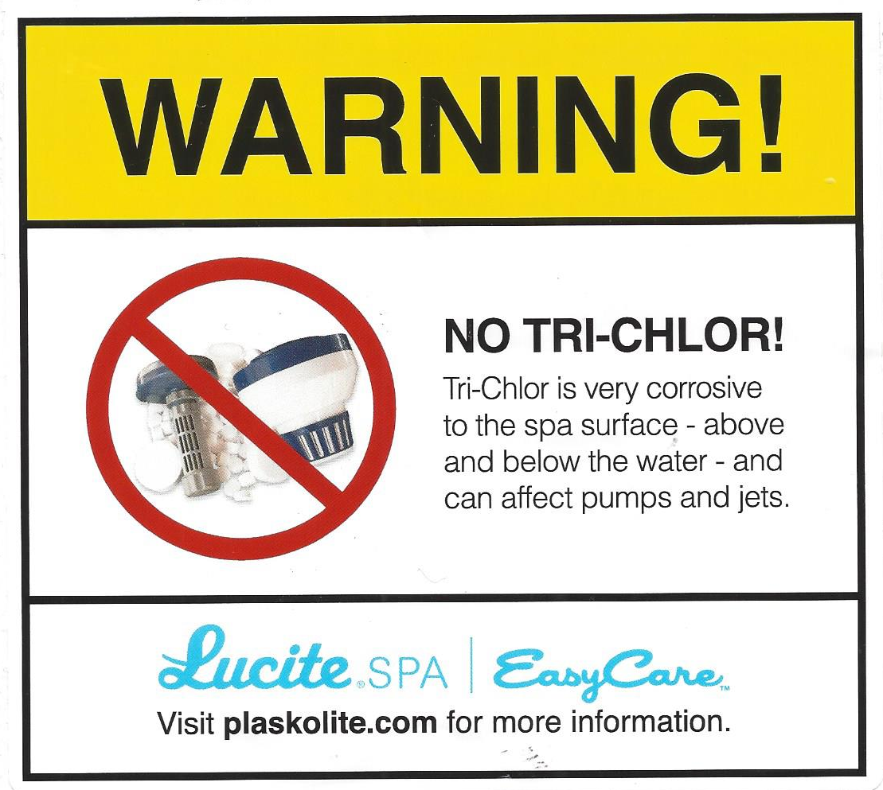
Tri Chlor Warning

Slide 29
Bromine
Same chemical family as chlorine (halogen family)
Effective in entire recommended pH range
Available as tablet, granular or powder
Fast acting in free and combined form
Notes:
Bromine is similar to chlorine in many ways. However, Bromine works well over a wide pH range. In addition, when Bromine reacts with bacteria and wastes, it does not reduce its ability to control bacteria and it does not cause odors, eye burn, or skin irritation.

Slide 30
Bromine Standards
 | SPATA | BISHTA
 | Commercial Spas | Domestic Hot Tubs
 | 4.0 – 6.0mg/l | 2.0 – 4.0mg/l
Business Use of a Domestic Hot Tub, eg at a Holiday Lodge
Bromine Residual should be in the range 4-6 mg/l
Notes:
Chlorine is the most widely used sanitizer for pools. That does not necessarily mean it is the best, only the long standing industry standard.
Chlorine is a fast acting sanitizer and will quickly react with a wide variety of wastes in addition to controlling bacteria. How well it works depends on the pH of the water and best efficiency is realized in the “free” form.

Slide 31

Bromine Overview
Bromine tablet manufacturers state that bromine tablets must be used in either a brominator (special erosion device) or an inline erosion feeder with flow control
Bromine granules are not suitable for shock dosing: use quick dissolving calcium hypochlorite
  eg Fi-Clor Superfast Spa Shock
  eg Certichem QD
  eg CPC Rapid Shock
  eg Plastica Rapid Shock
Notes:
Regardless of what role we play - dealer, distributor, service, or consumer, we want to prevent problems before they begin. The best way to do this is through a regular program of maintenance.

Slide 32
Water Supply - Paragraph 041
You must leave a 150 mm air gap between the end of the hose and the water in the Hot Tub.

Slide 33
Commissioning – HT4B Paras 042-045
Once commissioned, the Hot Tubs should be treated continuously as if in normal use.

Slide 34
Water Replacement – Paragraph 049
Where a hot tub is used as a business activity, the total water volume should be replaced each week, or after each rental, if earlier. When refilling after routine cleaning, it is good practice to add sufficient hypochlorite to achieve 5mg/l chlorine in the filled tub so that the pipework and fittings get a shock dose of disinfectant, and to avoid having a hot tub full of unchlorinated water.

Slide 35
Operational Action and Recommended Frequencies - Paragraph 051
Effective water treatment relies on filtration working in conjunction with chemical disinfection. Filtration that is working effectively and efficiently contributes to maintaining the cleanliness, clarity and safety of the water. Chemical disinfection is required to prevent microbial growth and reduce the risk of infection

Slide 36
Disinfection
Chemical
Treatment
Filtration
Treatment
Disinfection
Notes:
The first biological factor is disinfection - a word used to describe the control of micro-organisms.

Slide 37
Water Treatment – Paragraphs 055 & 056
Hot tubs should be filled with potable quality water (see above)
The pH should be maintained between 7.0 and 7.6 (preferably nearer to 7.0). Depending on the nature of incoming supply water and the disinfectant used, the pH of the water may need to be adjusted by the use of chemical treatment to ensure the disinfectant remains effective.

Slide 38
Adjusting the pH – Paragraph 057
The nature of the incoming mains water supply tends to determine the pH adjustment required. Heating water drives off acidic carbon dioxide so the natural tendency is for the pH to rise in hot tubs.
Sodium and calcium hypochlorite will result in an alkaline (basic) pH so an acid pH adjuster will be required. Acidic pH adjusters include sodium hydrogen sulphate (sodium bisulphate, dry acid).
Bromine products (eg bromochlorodimethylhydantoin) as well as some chlorine products (eg sodium dichloroisocyanurate dihydrate) tend to be relatively neutral when dissolved in hot tub water and have little effect on the pH. Products such as trichloroisocyanuric acid form an acidic solution (pH 3) in some but not all water supplies and an alkaline pH adjuster (eg soda ash, sodium carbonate) will be required to increase the pH to 7.0–7.6.

Slide 39
Cleanliness
The daily cleaning of the water line, including into the skimmer mouth and both sides of the Hot Tub cover and its surroundings is vital.
When such cleaning has been done, the cloth used should either be discarded to waste or sent for laundering at over 60°C, it should not be taken to another Hot Tub.
When the Hot Tub is drained down, a sample jet must be removed for cleaning and checking.

Slide 40
Cleanliness cont/d
Appendix 2 tells you how to make a cleaning solution of 100 mg/l of chlorine using various donors.

Slide 41
Recommended Inspection & Cleaning
Paragraph 059
Clean scum line with a fresh damp cloth/plastic scouring pad using sodium bicarbonate. Clean with a solution of 100mg/l free chlorine Clean both sides with a concentration of 100mg/l free chlorine. Dry and store in a clean area when not in use. A cover lifter should be used and designed to ensure the cover is kept off the ground at all times when not in use. Remove and clean all sides and housing. Remove, inspect and clean as necessary.
Review control strategies as cloudiness may indicate: • low disinfectant concentration • the hot tub left unused • failure of the circulation pump • incorrect dosing of water treatment chemicals resulting in the presence of undissolved chemicals • incorrect filter cleansing procedures • algal/bacterial growth • hot tub overloaded • presence of foam

Slide 42
Microbiology
Persistent poor microbiology results requires a deep clean and use of chlorine dioxide tablets

Slide 43
Chemical Storage – Paragraph 072
Acids, alkalis and disinfectants should be stored appropriately in a secure, non-public, well-ventilated, dry storage area, preferably separate from any plant. Each area should have heating and frost protection and be marked with an appropriate warning sign. These should be bunded (the bund should be able to contain at least 110% of the maximum volume of liquid stored) and separated to contain any spillage of liquid chemicals and possible mixing of acids and alkalis – where highly toxic chlorine gas may be produced. Storage information is provided in the safety data sheets.

Slide 44
Dangerous Goods – Paragraph 073
The Law requires everyone involved to have had training appropriate to their duties and for which a Certificate has to be provided.

Slide 45
Filter Cleaning & Drying
Use an eg dedicated dishwasher

Slide 46
Recording
Record problems such as pump breakdown in the log.
Keep testing records over 5 years

Slide 47
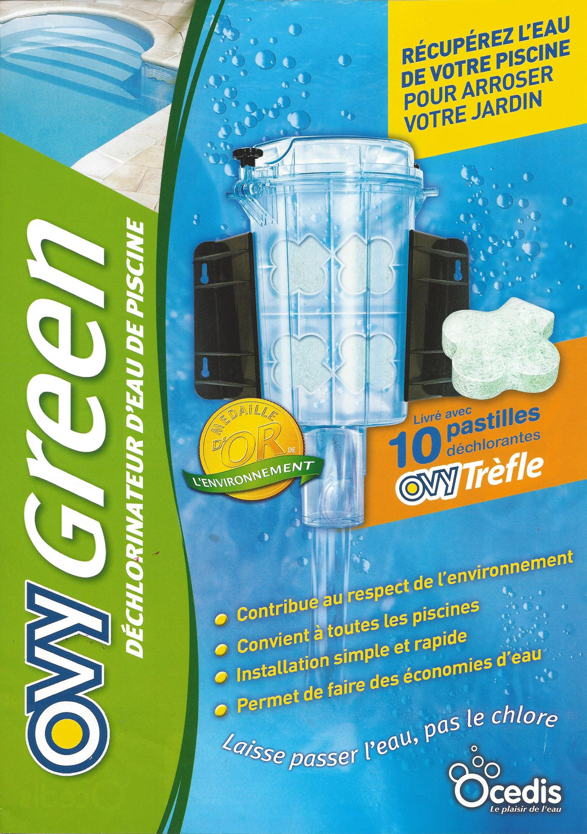
Always learning
Water disposal
and then dechlorination

Slide 48
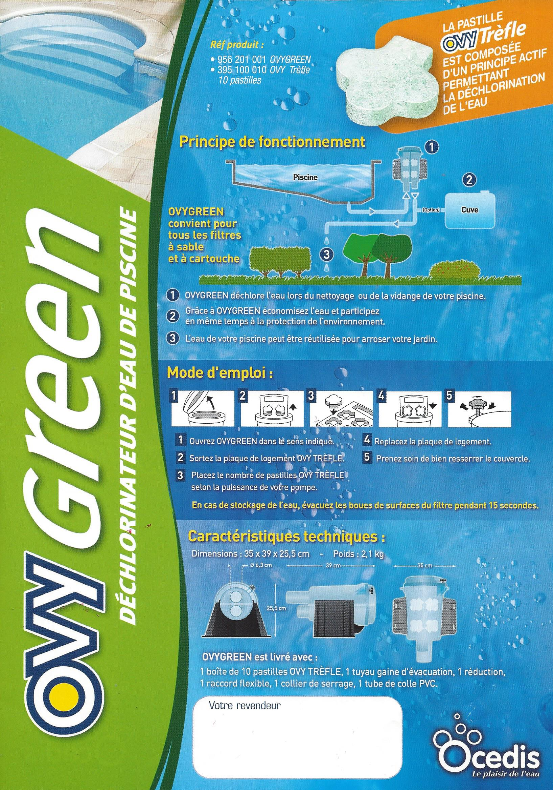

Slide 49
Calcium Hypochlorite
Just come to the UK
Slow Dissolving Calcium Hypochlorite Tablets

Slide 50
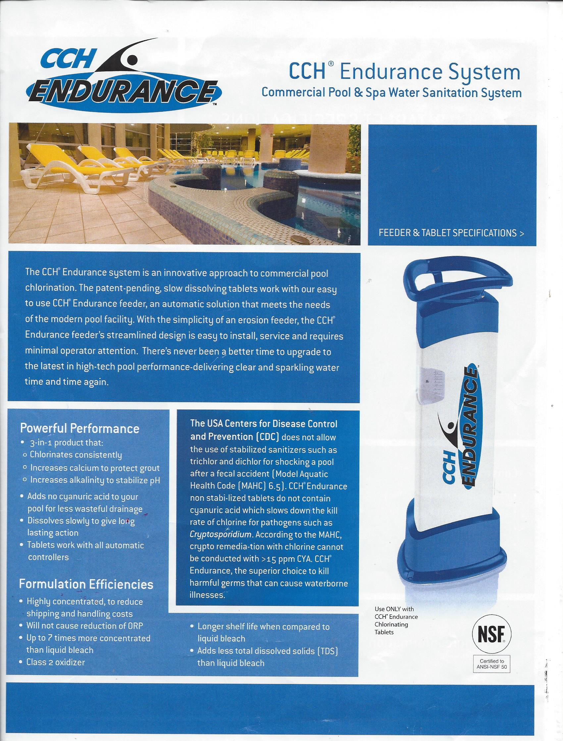

Slide 51
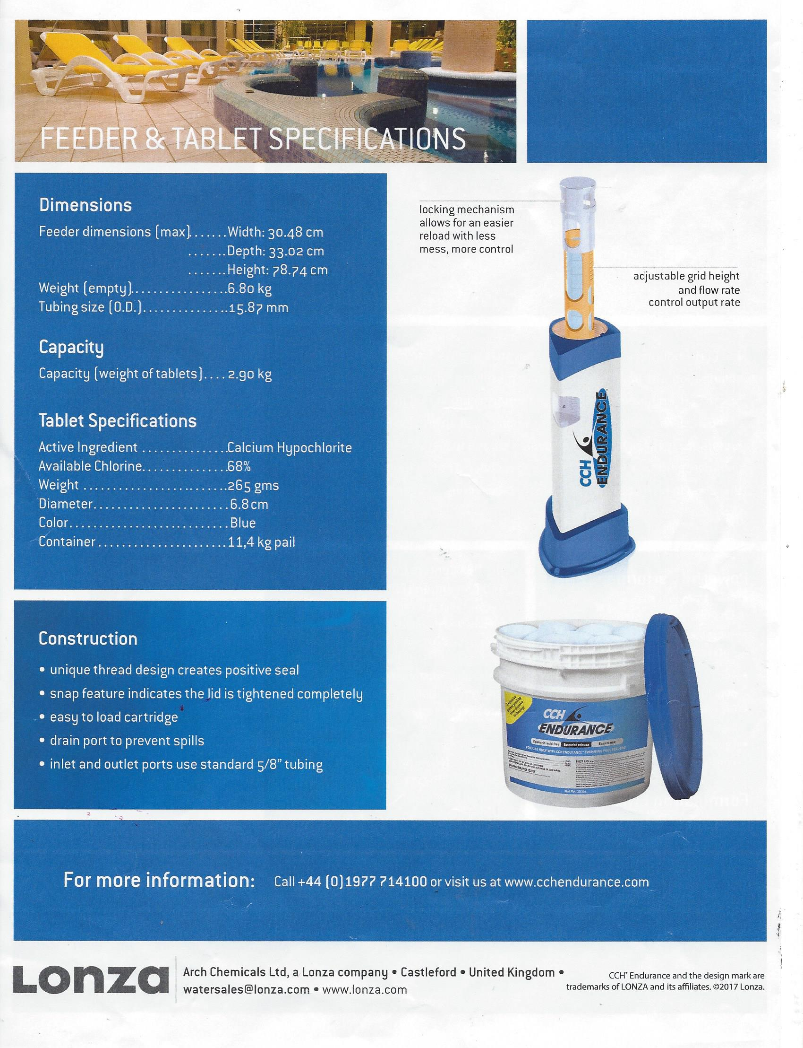
Lonza is now Sigura

Slide 52
SPATEX 2021
25th Anniversary
Ricoh Arena Centre, Coventry
Ericsson Exhibition Hall
2nd,3rd, 4th February 2021
www.spatex.co.uk

