Slide 1
Code of Practice
POOLMARK Quality Award
Mike Shuff, M.PWTAG
PWTAG Council Member
PALM Academy Ltd
SPATEX 2020

Slide 2

Pool Water Treatment Advisory Group
There is no Government involvement in the standards for swimming pool water since the demise of the DOE document in the LAST CENTURY!!
Yet, there are many “government-led” pieces of legislation that will be raised against us, if we don’t observe best practices!
PWTAG Council is made up of individuals from a wide range of interests, and it sets the standards for the industry to follow!

Slide 3

Pool Water Treatment Advisory Group
Anybody can write a set of guidelines; so what puts PWTAG in the forefront?
PWTAG is recognised by the Health & Safety Executive
The guidelines come from experts to give PWTAG Council the correct information to put out in the industry to minimise problems occurring.
  filtration
  the study of Cryptosporidium
  HOT TUBS!!!!
  Hydrotherapy-Canine-Equine.
This will ensure that if these guidelines are followed, then the operator can be confident that should an incident occur – then the organisation can be protected.

Slide 4
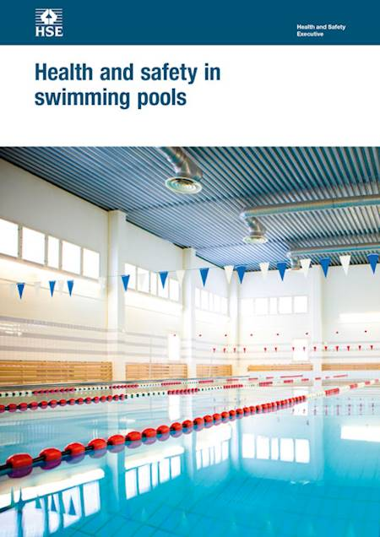
HSG 179 (2018) Page 4
7 The document gives management advice and technical information on health and safety in swimming pool design and pool water treatment. The information on swimming pool design and pool water treatment is only an introduction to these topics.
For more in-depth technical information, you should refer to the specific industry guidance listed below:
The Pool Water Treatment Advisory Group (PWTAG) Code of Practice (www.pwtag.org);
The Swimming Pool Water Book (www.pwtag.org);
PWTAG Technical notes (www.pwtag.org);
Sport England documents, etc

Slide 5
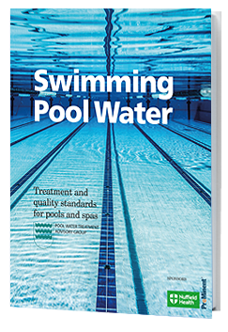
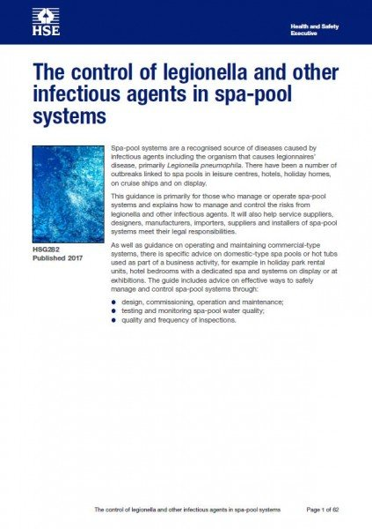
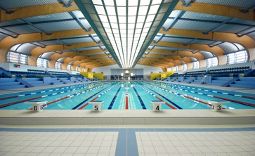
Code of Practice
THE MANAGEMENT AND TREATMENT OF SWIMMING POOL WATER
(PWTAG)
HSG 179
Health and Safety in Swimming Pools
Swimming Pool Water: Treatment and Quality Standards.
The blue book from PWTAG
PHE/HSG 282--2017
These are the “MUST HAVE” guidelines!

Slide 6
The Code of Practice
This is a working document updated as needed from requirements in the industry
It is FREE to download as we feel that all pools will benefit from the information.
It can be used as an audit tool.
It is not a legal document but industry best practice
HSE recognises this in the document HSG 179

Slide 7
Legalities of Guidelines and Codes of Practice
          Codes and Guidelines are Not Law — however ………….
          Law professionals will seek guidance on industry guidelines to ESTABLISH CAUSE; could it have been avoided if guidelines were followed?
Insurers will PRESUME that operatives are following guidelines for levels of compensation-they may refuse to pay out if there are no written procedures
Skills cards-training records-signed staff performance reviews-updated NOP/EAP
Highlighting deficiencies—all covered in C.o.P.

Slide 8

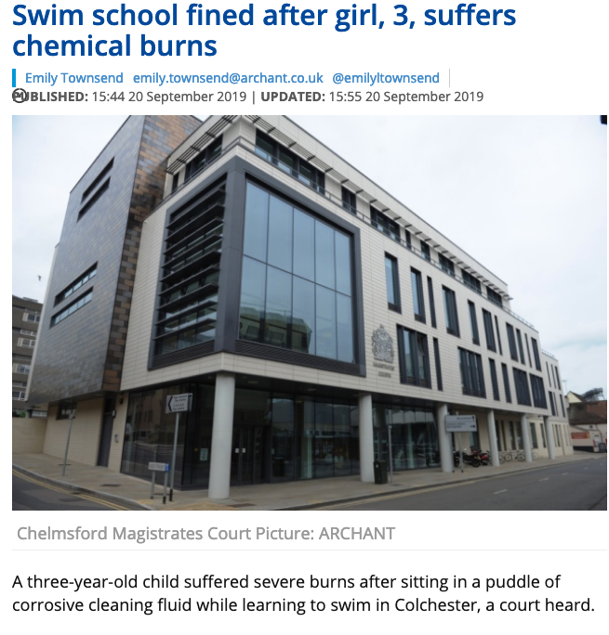
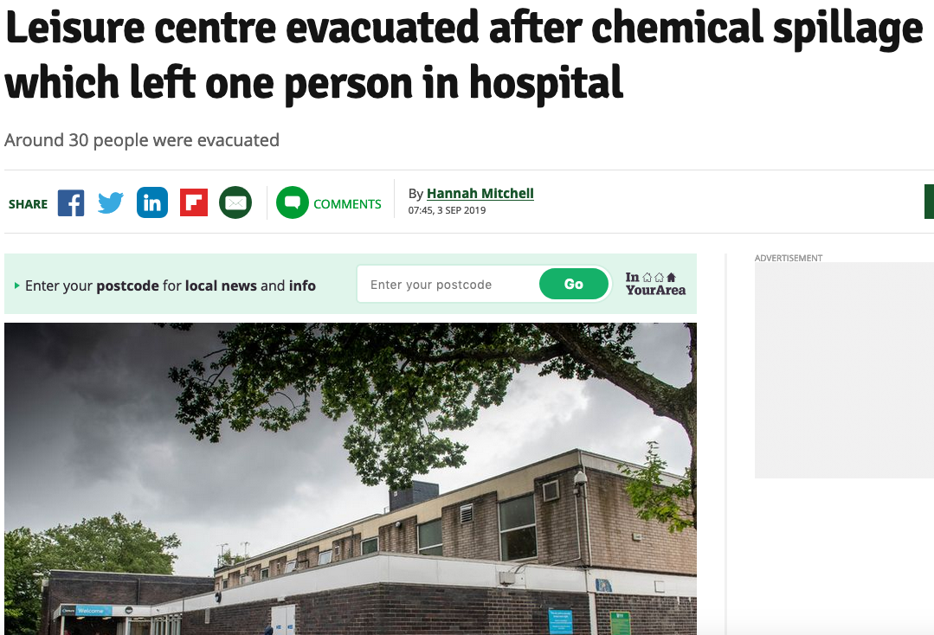
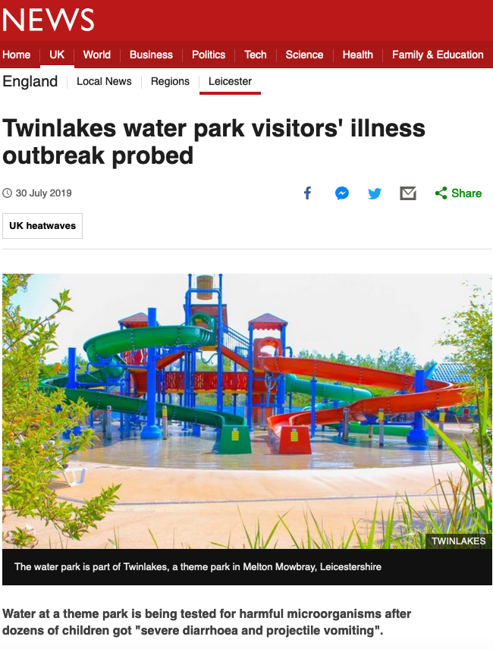
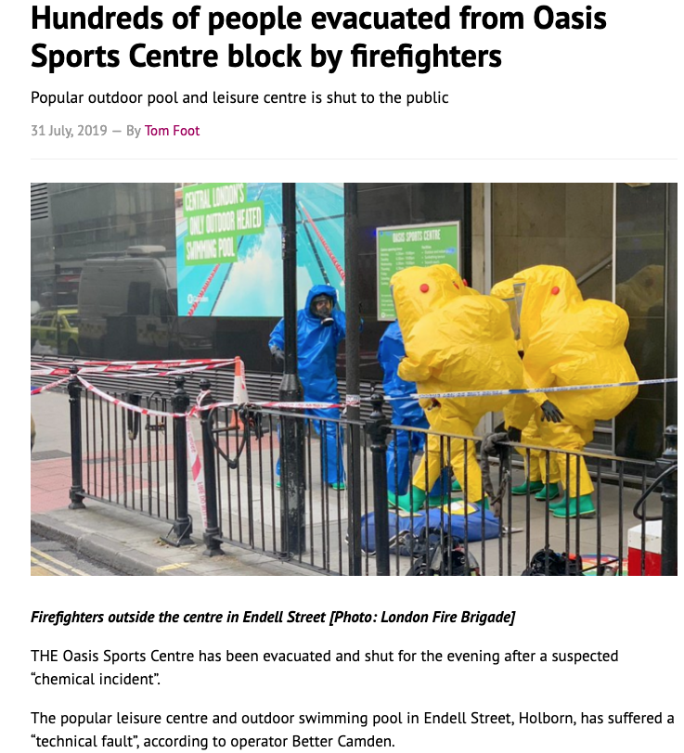
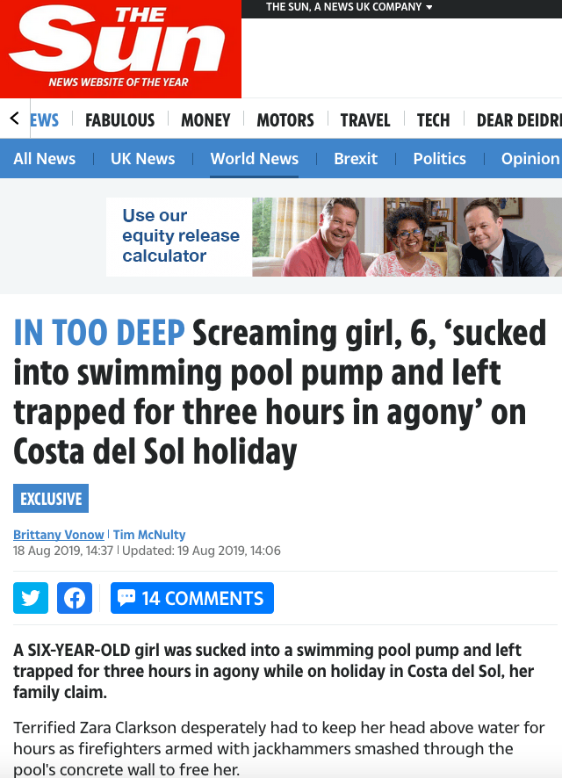
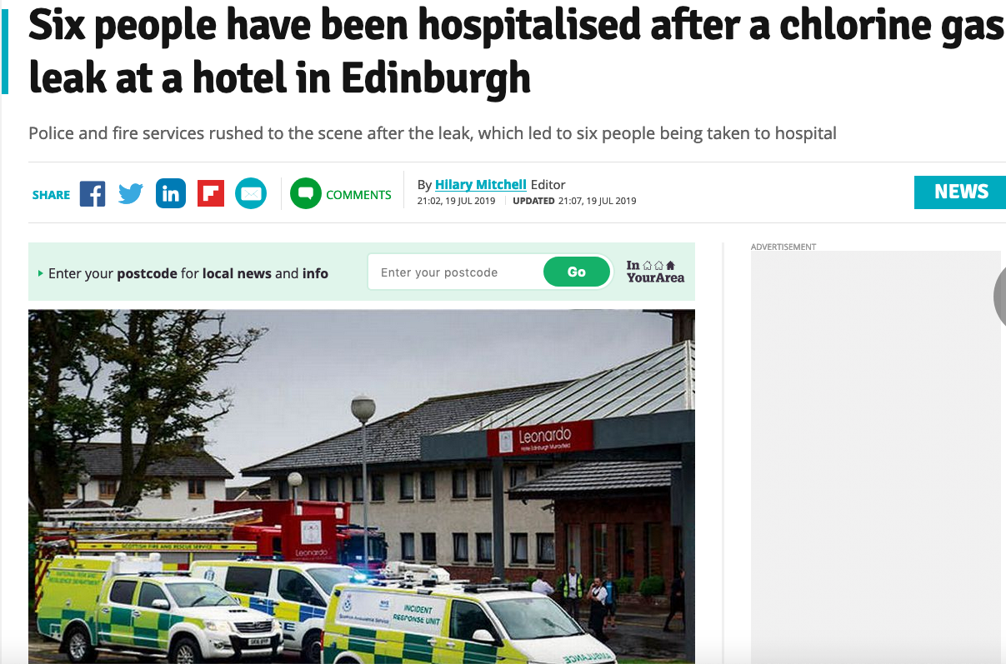
PoolMark
It is essential, as we have just seen, to be able to measure how safe a pool is operating. Particularly with the incidents reported in the press recently.

Slide 9

PoolMark
Chemical spillages
  gas alerts
Infection outbreaks(Giardia/Crypto)
  Fatalities
to point out just a few.
              Well the good news is that from the ‘Blue Book’ and the Code of Practice --- WE NOW CAN!!!

Slide 10

PoolMark
From 2019, PWTAG have offered pools the opportunity to have their pool/organisation accredited through
PoolMark.
PALM Academy Ltd have been commissioned to offer a totally unbiased examination of the operation of a pool based on the criteria set out on the PWTAG website, this includes:
Management strategy-training-qualifications-organisation-record keeping etc

Slide 11
PoolMark Assessment
The assessment will comprise of a visit to assess how your pool performs against the current C.o.P. and will look at:-
    Filtration
    Disinfection
    Record keeping
    Job tasks
    Professional training standards
    Risk Assessments and Safety Documentation
      This list is not exhaustive (visit www.palmacademy.co.uk) for full details.

Slide 12
PoolMark Assessment
There are several “RED-LINES”; these are the absolute ‘must haves’. If you don’t have these, don’t apply for accreditation!!
      Some of these, include:-
        Flow meter readings
        Backwash timings
        Pool schematics
        Holders of an SPTO (any accredited provider)
        Range and frequency of water testing
        Risk assessments, and NOP/EAP and PTOP …
        the POOL TECHNICAL OPERATING PROCEDURE

Slide 13
Pool Technical Operating Procedure
5.d. Filtration In accordance with PWTAG model Code of Practice: Section 6.14 In accordance with PWTAG model Code of Practice: Section 6.17 In accordance with PWTAG model Code of Practice: Section 6.15 In accordance with PWTAG model Code of Practice: Section 6.16 | Filters and filtration rate To ensure that adequate filtration is provided, for the type and use of the pool. Backwashing To ensure that filters and media are cleaned and able to perform at their optimum level. Serviceable filters To ensure that filtration services are adequate for the use of the pool. Annual inspection To identify any damage or fall off in efficiency. | What is the:- Type and number of filters What is the total surface area and bed depth of filter media? What is the filter media, and frequency of media change What are the:- What are the frequency and timings of filter backwashing? What are the trigger points for backwashing? Are working pressure gauges installed? Are the filters designed in accordance with industry standards and requirements? What is the frequency for the internal inspection of filters for wear and tear, or other damage, and issues with the filter medium?

Slide 14
5.e. Disinfection Primary disinfection: In accordance with PWTAG model Code of Practice: Section 6.5 Secondary disinfection: In accordance with PWTAG model Code of Practice: Section 6.6 Dilution: In accordance with PWTAG model Code of Practice: Section 6.7 | Primary disinfection To assist in the destruction of bacteria, spores and other organic material Secondary disinfection To assist in the prevention of cryptosporidium and to reduce combined chlorine levels Dilution with fresh water To reduce and remove the amount of pollution within the pool, including the build-up of chemical compounds. | 1. What is the primary disinfectant used and the method used to introduce it. 2. What are the acceptable levels for safe operation 3. How is it monitored? 1. If any secondary disinfection is installed, how is it administered and monitored? 2. If Ultra Violet light is installed, is it validated to NSF/ANSI 50 and what is the frequency of re-validation? 1. What is the rate of dilution. 2. How is it measured and recorded.
5.f. pH stabilisation | To control the pH of pool water, to enable optimum performance of disinfectants, and provide bather comfort. | 1. What is the primary pH stabiliser used and the method used to introduce it. 2. What are the acceptable levels for safe operation 3. How is it monitored?

Slide 15

THE POOLMARK ASSESSMENT CHECKLIST
What will you need to do; what will you need to produce?
ESSENTIAL CRITERIA | These are the items or processes that should be in place |  | What you must be able to produce or demonstrate, during the assessment visit.
MANAGEMENT PROTOCOLS and DOCUMENTATION | Pool Safety Operating Procedure Pool Risk Assessments Pool Technical Operating Procedure Lone working and noise risk assessment Legionella risk assessment Cryptosporidia risk assessment Blood and Vomit procedures Baby and young children policy |  | You must be able to produce an up-to-date copy of each of these. They must be relevant; complete, in date and properly signed. The template for the Pool Technical Operating Certificate can be found at www.carltonassociates.co.uk PWTAG Handbook “Swimming Pool Water; Treatment & Quality Standards”. (pages 248 – 258), or download at www.publichealthwales. org/cryptopoolguidance
PLANT ROOM AND CHEMICAL STORES | Security Skills cards/SOP’s Written procedures for:- Dosing preparation procedure Daytank filling procedure Injector cleaning procedure Circulation feeders Chemical deliveries |  | There should be written instruction and procedures, for the range of tasks within a plant room; these will need to be seen.

Slide 16
PoolMark Accreditation
What does a pool get out of it?
Knowledge that the pool is operating to current industry standards.
Staff are being trained regularly as prescribed and not just updated every few years.
Documentation is available for external review if needed by EHO, and seen by the public, etc.
Satisfaction that should a legal claim be made then the Operator/Manager can show that they have followed the current industry best practice
FEES!!!! £550 for up to 5 facilities, plus £100 for the PWTAG plaque for each facility.

Slide 17
PoolMark Accreditation
How do you get started, then?
Go to www.palmacademy.co.uk and click on ‘PoolMark’
Click on ‘PoolMark_pre-assessment_checklist_v2a.2019.pdf, and see how you compare.
Complete the Application Form and submit to PALM Academy Ltd (www.palmacademy.co.uk)
You will then be contacted to see of you want a pre-assessment visit, or whether you want to go for it, straight away!

Slide 18
Thank you!
www.pwtag.org
www.palmacademy.co.uk

